Slide 1


ADMIS Lab
先进数据与机器智能系统实验室
Relational Database Design
Chapter 7
Yichao Zhang
Email: yichaozhang@tongji.edu.cn
Department of Computer Science and Technology
Tongji University

Slide 2
Outline
Features of Good Relational Designs
Functional Dependency/函数依赖
  Decomposition using functional dependency
  Closure of functional dependency
  Closure of attribute sets
  Canonical cover
  Lossless-join decomposition
  Dependency preservation
Normalization & Normal Forms (范式)
Multivalued Dependencies*
Database Design Process

Slide 3
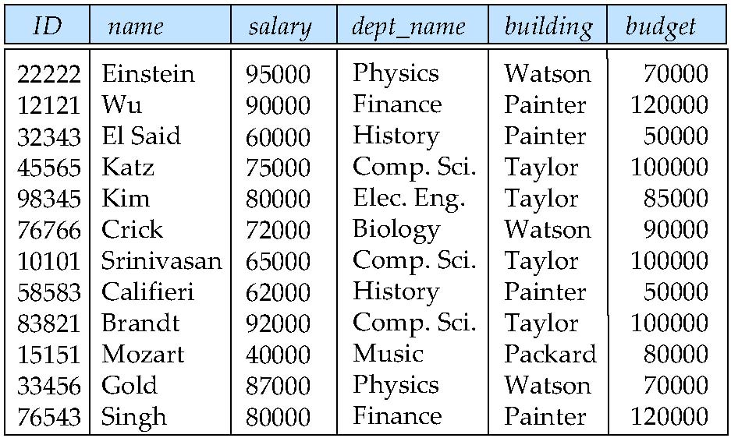
Larger Relation Schema/更大的模式
in_dep (ID, name, salary, dept_name, building, budget)
  Instructor + department

Slide 4
Larger Relation Schema/更大的模式
in_dep (ID, name, salary, dept_name, building, budget)
  Redundant（冗余）: dept_name, building, budget
  Inconsistent（不一致）: dept_name, building, budget
  Insert failure: cannot insert a tuple without ID, name, salary
Functional dependency is needed
  dept_name → budget
Decomposition
  instructor(ID, name, salary, dept_name)
  department(dept_name, building, budget)
Notes:
某些用户可能更新一条元组里的预算金额而不是所有元组中预算金额，因此会产生不一致的风险。

Slide 5
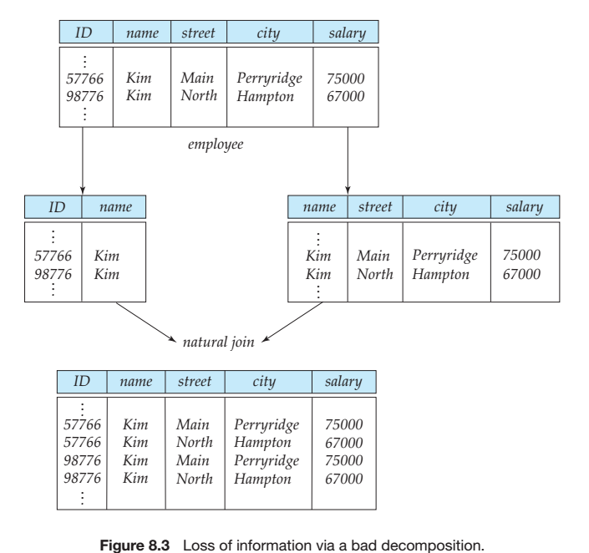
Smaller Relation Schema/更小的模式
More tuples mean lossy decompositions

Slide 6
Good Relation Schema
RDB design is to find a “good” collection of schemas. A bad design may lead to
  Repetition of information
  Inability to represent certain information
Design goals
  Avoid redundant data
  Ensure that relationships among attributes are represented
  Facilitate the checking of updates for violation of database integrity constraints

Slide 7
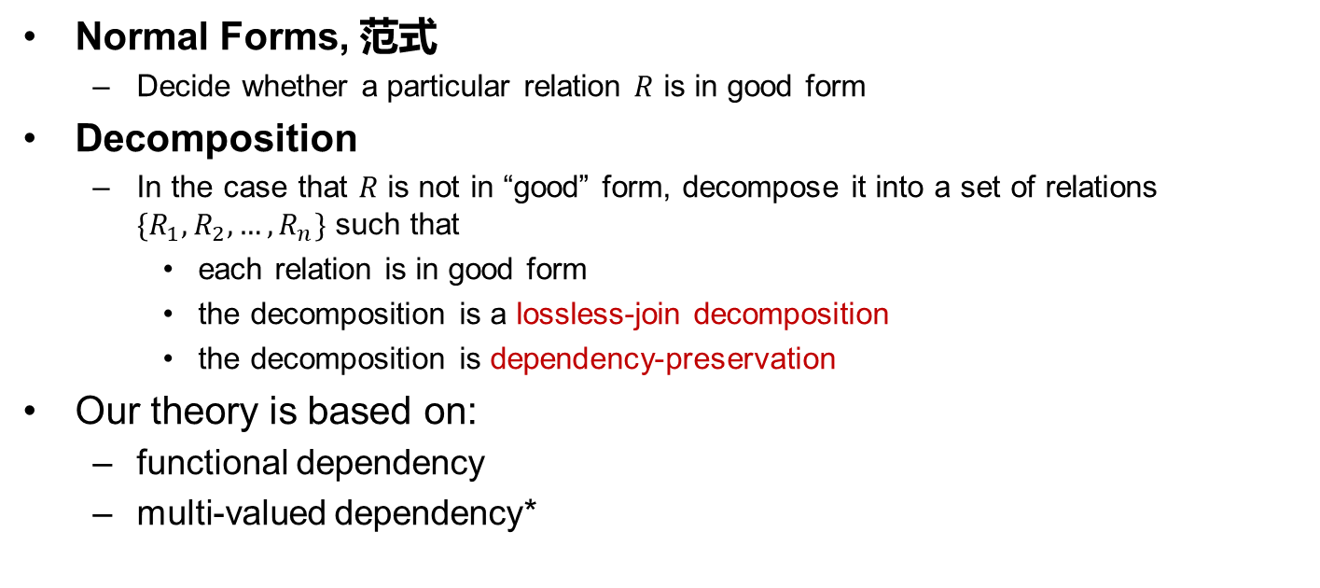
Goal - Devise a Method for the Following
Normal Forms, 范式
  Decide whether a particular relation $R$ is in good form
Decomposition
  In the case that $R$ is not in “good” form, decompose it into a set of relations $\{R_{1},R_{2},…,R_{n}\}$ such that
    each relation is in good form
    the decomposition is a lossless-join decomposition
    the decomposition is dependency-preservation
Our theory is based on:
  functional dependency
  multi-valued dependency*

Slide 8
Outline
Features of Good Relational Designs
Functional Dependency/函数依赖
  Decomposition using functional dependency
  Closure of functional dependency
  Closure of attribute sets
  Canonical cover
  Lossless-join decomposition
  Dependency preservation
Normalization & Normal Forms (范式)
Multivalued Dependencies*
Database Design Process

Slide 9
Functional Dependency (函数依赖)
Functional dependency
  The value for a certain set of attributes determines uniquely the value for another set of attributes
  A functional dependency is a generalization of the notion of key

Slide 10
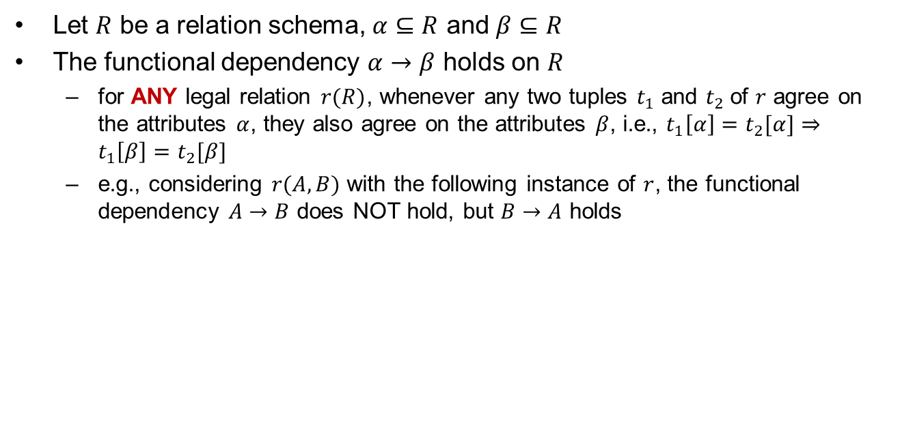
Functional Dependency (Cont.)
Let $R$ be a relation schema, $α⊆R$ and $β⊆R$
The functional dependency $α→β$ holds on $R$
  for ANY legal relation $r(R)$, whenever any two tuples $t_{1}$ and $t_{2}$of $r$ agree on the attributes $α$, they also agree on the attributes $β$, i.e., $t_{1}\left[α\right]=t_{2}[α]⇒t_{1}\left[β\right]=t_{2}[β]$
  e.g., considering $r(A,B)$ with the following instance of $r$, the functional dependency $A→B$ does NOT hold, but $B→A$ holds
4
1 5
3 7

Slide 11
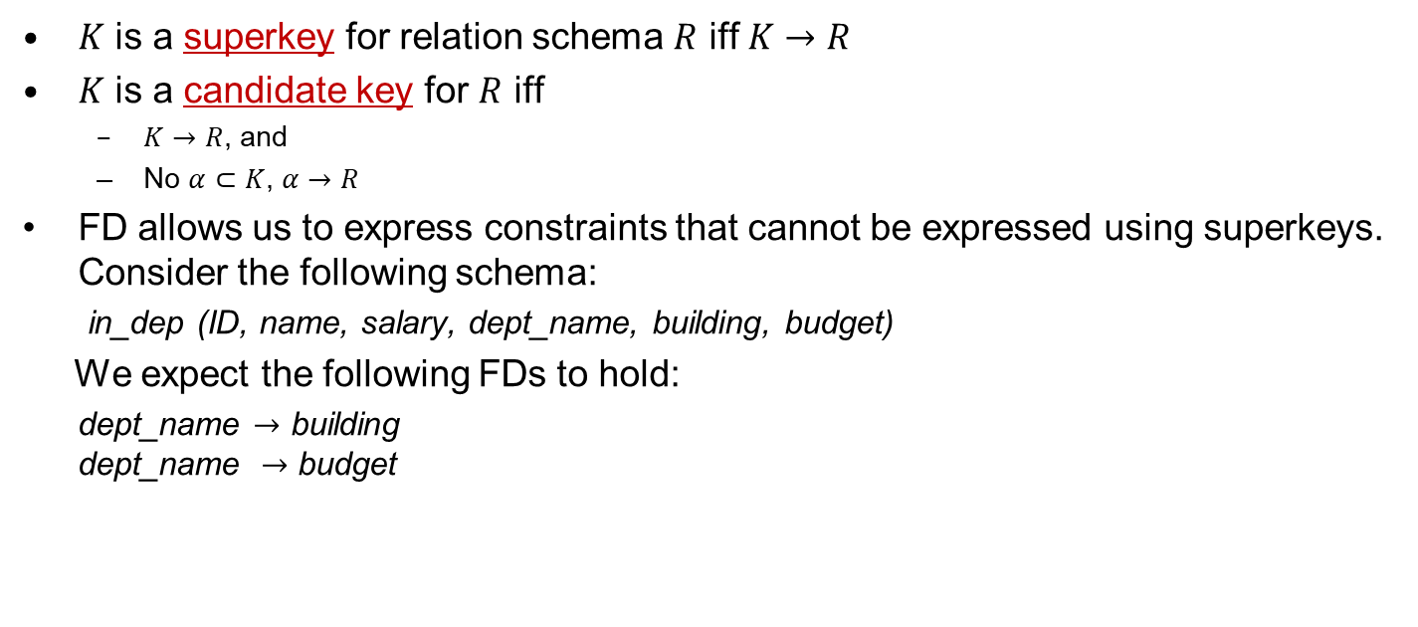
Functional Dependency (Cont.)
$K$ is a superkey for relation schema $R$ iff $K→R$
$K$ is a candidate key for $R$ iff
  $K→R$, and
  No $α⊂K$, $α→R$
FD allows us to express constraints that cannot be expressed using superkeys. Consider the following schema:
in_dep (ID, name, salary, dept_name, building, budget)
We expect the following FDs to hold:
dept_name $→$ building
dept_name $→$ budget

Slide 12
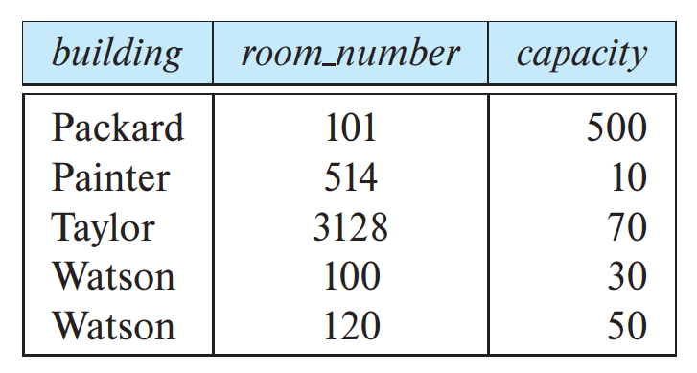
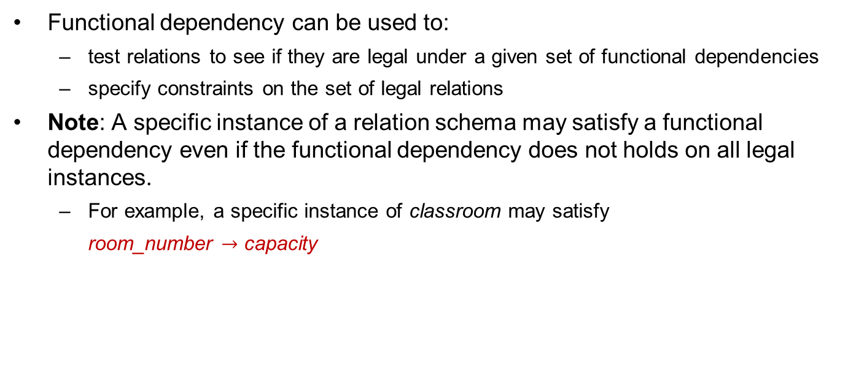
Applications of Functional Dependencies
Functional dependency can be used to:
  test relations to see if they are legal under a given set of functional dependencies
  specify constraints on the set of legal relations
Note: A specific instance of a relation schema may satisfy a functional dependency even if the functional dependency does not holds on all legal instances.
  For example, a specific instance of classroom may satisfy
  room_number $→$ capacity

Slide 13
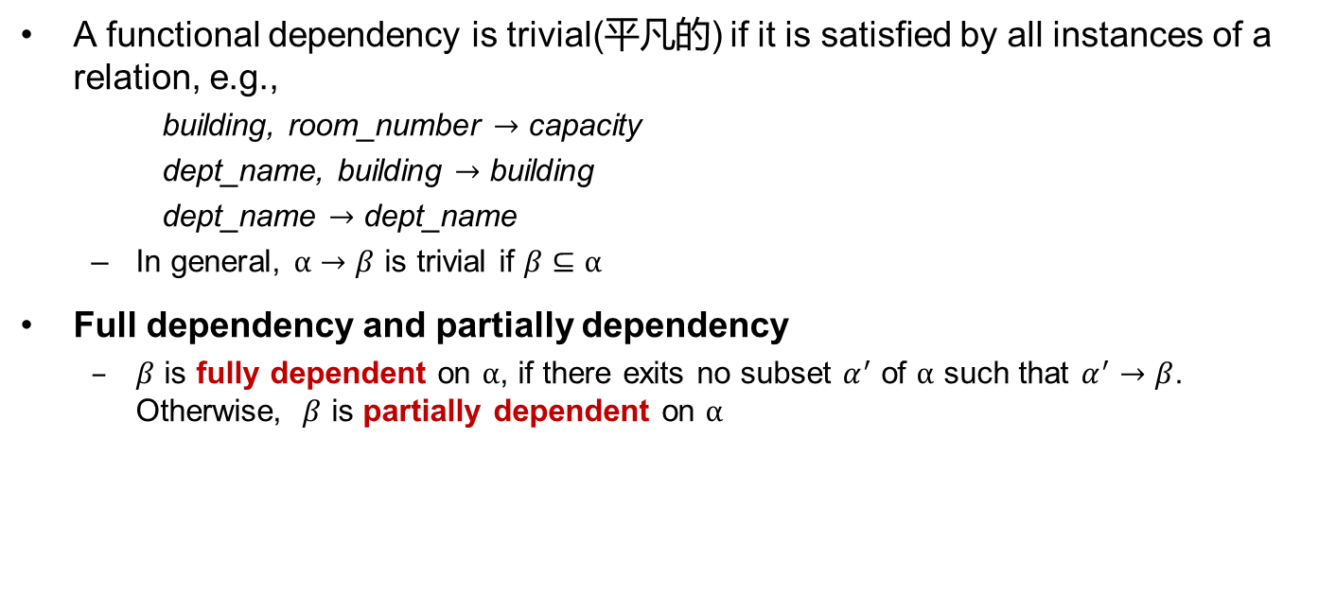
Functional Dependencies (Cont.)
A functional dependency is trivial(平凡的) if it is satisfied by all instances of a relation, e.g.,
    building, room_number $→$ capacity
    dept_name, building $→$ building
    dept_name $→$ dept_name
  In general, $α→β$ is trivial if $β⊆α$
Full dependency and partially dependency
  $β$ is fully dependent on $α$, if there exits no subset $α^{′}$ of $α$ such that $α^{′}→β$. Otherwise, $β$ is partially dependent on $α$

Slide 14
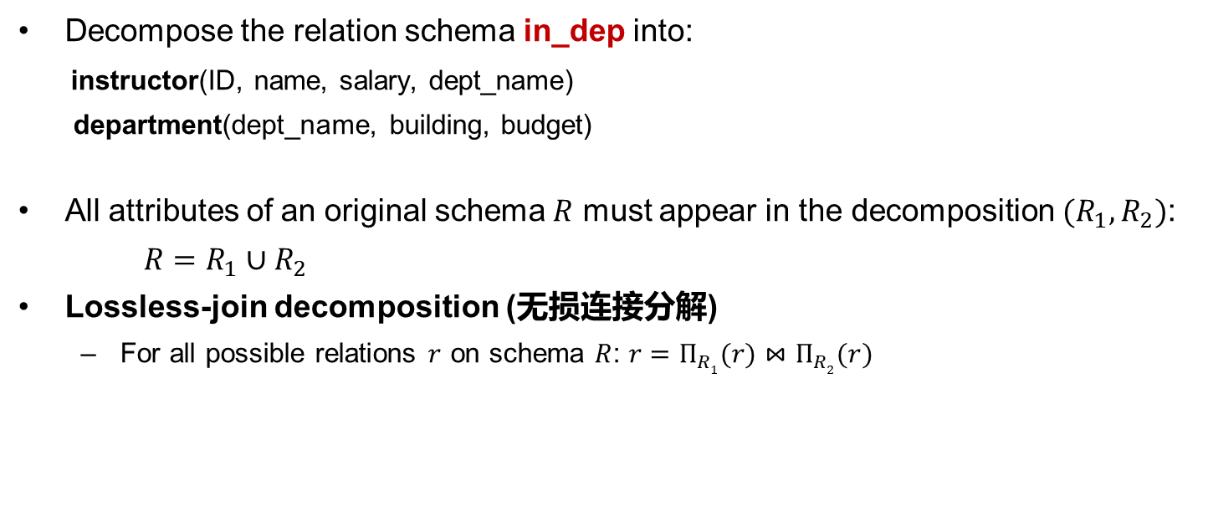
Decomposition
Decompose the relation schema in_dep into:
instructor(ID, name, salary, dept_name)
department(dept_name, building, budget)
All attributes of an original schema $R$ must appear in the decomposition $(R_{1},R_{2})$:
$R=R_{1}∪R_{2}$
Lossless-join decomposition (无损连接分解)
  For all possible relations $r$ on schema $R$: $r=Π_{R1}(r)⋈Π_{R2}(r)$

Slide 15



Lossy-join Decomposition
Decomposition of R = (A, B, C)
  R₁ = (A,C), R₂ = (B,C)
$$r$$
$$Π_{A,C}(r)$$
$$Π_{B,C}(r)$$
A | B | C
α | 1 | 1
α | 2 | 1
β | 1 | 1
A | C
α | 1
β | 1
B | C
1 | 1
2 | 1
A | B | C
α | 1 | 1
α | 2 | 1
β | 1 | 1
β | 2 | 1
∏_{A, C} (r) ∏_{B, C} (r)

Slide 16
Outline
Features of Good Relational Designs
Functional Dependency/函数依赖
  Decomposition using functional dependency
  Closure of functional dependency
  Closure of attribute sets
  Canonical cover
  Lossless-join decomposition
  Dependency preservation
Normalization & Normal Forms (范式)
Multivalued Dependencies*
Database Design Process

Slide 17
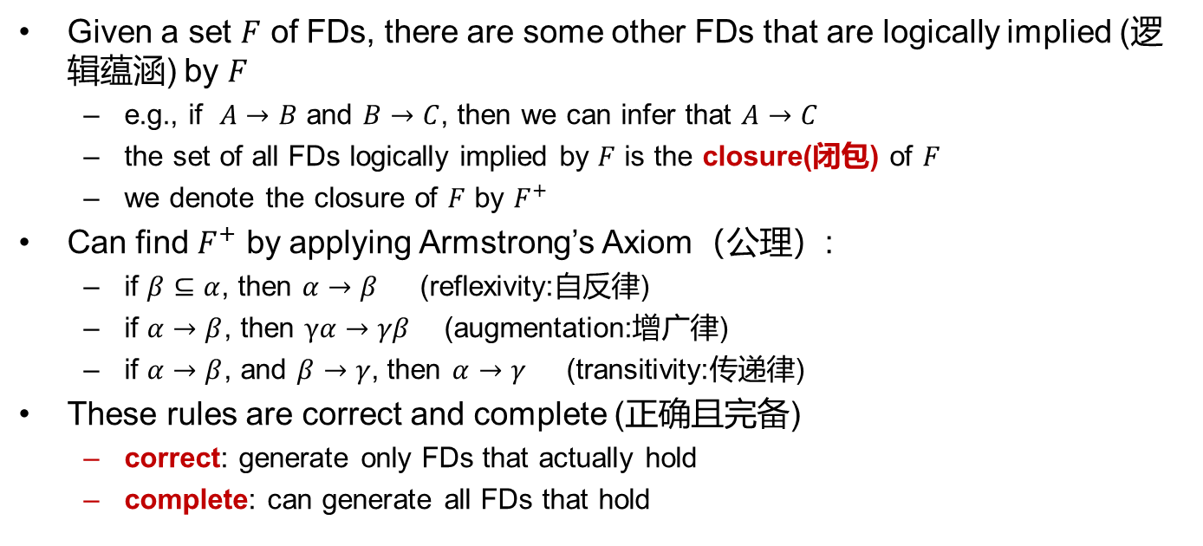
Closure of a Set of Functional Dependencies
Given a set $F$ of FDs, there are some other FDs that are logically implied (逻辑蕴涵) by $F$
  e.g., if $A→B$ and $B→C$, then we can infer that $A→C$
  the set of all FDs logically implied by $F$ is the closure(闭包) of $F$
  we denote the closure of $F$ by $F^{+}$
Can find $F^{+}$ by applying Armstrong’s Axiom（公理）:
  if $β⊆α$, then $α→β$ (reflexivity:自反律)
  if $α→β$, then $γα→γβ$ (augmentation:增广律)
  if $α→β$, and $β→γ$, then $α→γ$ (transitivity:传递律)
These rules are correct and complete (正确且完备)
  correct: generate only FDs that actually hold
  complete: can generate all FDs that hold

Slide 18
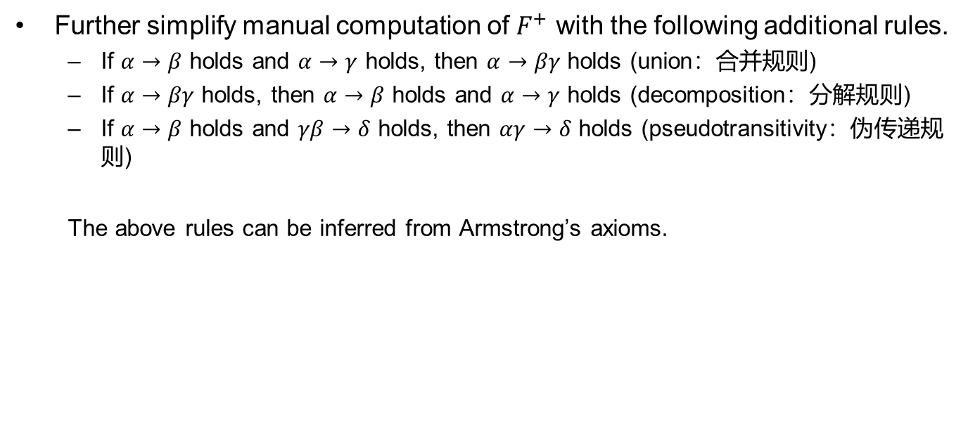
Closure of Functional Dependencies (Cont.)
Further simplify manual computation of $F^{+}$ with the following additional rules.
  If $α→β$ holds and $α→γ$ holds, then $α→βγ$ holds (union：合并规则)
  If $α→βγ$ holds, then $α→β$ holds and $α→γ$ holds (decomposition：分解规则)
  If $α→β$ holds and $γβ→δ$ holds, then $αγ→δ$ holds (pseudotransitivity：伪传递规则)
  The above rules can be inferred from Armstrong’s axioms.

Slide 19
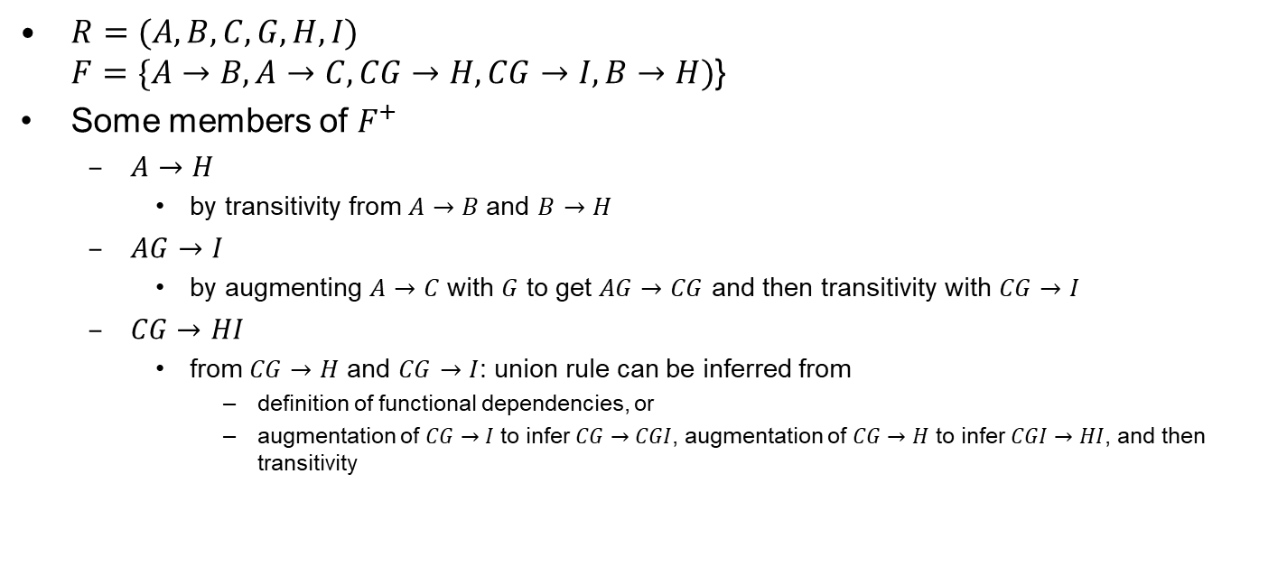
Example
$R=(A,B,C,G,H,I)$
$F=\{A→B,A→C,CG→H,CG→I, B→H)$}
Some members of $F^{+}$
  $A→H$
    by transitivity from $A→B$and $B→H$
  $AG→I$
    by augmenting $A→C$ with $G$ to get $AG→CG$ and then transitivity with $CG→I$
  $CG→HI$
    from $CG→H$ and $CG→I$: union rule can be inferred from
      definition of functional dependencies, or
      augmentation of $CG→I$ to infer $CG→CGI$, augmentation of $CG→H$ to infer $CGI→HI$, and then transitivity

Slide 20


Procedure for Computing $F^{+}$
To compute the closure of a set of FDs $F$:
NOTE: We will see an alternative way for this task later
$$F^{+}=F$$
repeat
for each FD $f$ in $F^{+}$
apply reflexivity and augmentation rules on $f$
add the resulting FDs to $F^{+}$
for each pair of FDs $f_{1}$ and $f_{2}$ in $F^{+}$
if $f_{1}$ and $f_{2}$ can be combined using transitivity
add the resulting FD to $F^{+}$
until $F^{+}$does not change any more

Slide 21
$$F^{+}$$
R(X,Y,Z), F = {X→Y, Y→Z}, F⁺ ？
F⁺ = {
X→Φ, Y→Φ, Z→Φ, XY→Φ, XZ→Φ, YZ→Φ, XYZ→Φ,
X→X, Y→Y, Z→Z, XY→X, XZ→X, YZ→Y, XYZ→X,
X→Y, Y→Z, XY→Y, XZ→Y, YZ→Z, XYZ→Y, X→Z,
Y→YZ, XY→Z, XZ→Z, YZ→YZ, XYZ→Z, X→XY, XY→XY,
XZ→XY, XYZ→XY, X→XZ, XY→YZ, XZ→XZ, XYZ→YZ, X→YZ,
XY→XZ, XZ→YZ, XYZ→XZ, X→XYZ, XY→XYZ, XZ→XYZ, XYZ→XYZ}
F={X→A₁, …… , X→A_{n}}, computing F⁺ is a NP problem

Slide 22
Outline
Features of Good Relational Designs
Functional Dependencies
  Decomposition using Functional Dependencies
  Closure of Functional Dependencies
  Closure of Attribute Sets
  Canonical Cover
  Lossless-join Decomposition
  Dependency Preservation
Normalization & Normal Forms (范式)
Multivalued Dependencies*
Database Design Process

Slide 23
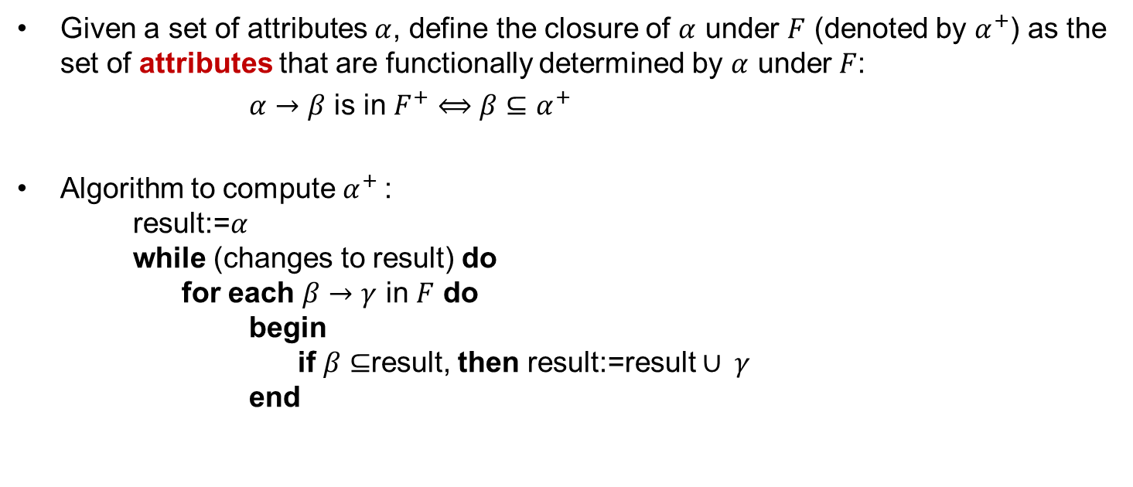
Closure of Attribute Set (属性集的闭包)
Given a set of attributes $α$, define the closure of $α$ under $F$ (denoted by $α^{+}$) as the set of attributes that are functionally determined by $α$ under $F$:
$α→β$ is in $F^{+}$ $⟺$ $β⊆α^{+}$
Algorithm to compute $α^{+}$:
result:=$α$
while (changes to result) do
for each $β→γ$ in $F$ do
begin
if $β⊆$result, then result:=result $∪ γ$
end

Slide 24
Example of Attribute Set Closure
Given R<U, F>, U = {A, B, C, D, E}, F={AB→C, B→D, C→E, EC→B, AC→B};
Compute: (AB)_{F}⁺, (AC)_{F}⁺, (EC)_{F}⁺
X⁽⁰⁾={A, B}；
First loop:
X⁽¹⁾: for each FD in F, find FDs that the left hand side(LHS) is A,B or AB, then AB→C, B→D, and X⁽¹⁾={A, B}∪{C, D}={A, B, C, D};
Second loop:
X⁽¹⁾≠X⁽⁰⁾, find FDs that the left hand side is the subset of {ABCD}, then AB→C, B→D, C→E, AC→B, and X⁽²⁾=X⁽¹⁾∪{C, D, E, B}={A, B, C, D, E};
X⁽²⁾=U, all attributes are in X⁽²⁾, so (AB)_{F}⁺ = {A, B, C, D, E}.
(AC)_{F}⁺ = ??? (EC)_{F}⁺ = ???
(AC)_{F}⁺ = {A,B,C,D,E}； (EC)_{F}⁺ = {B,C,D,E}

Slide 25
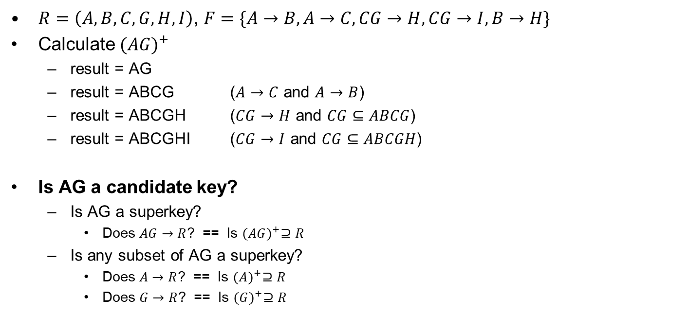
Example of Attribute Set Closure
$R=\left(A,B,C,G,H,I\right)$, $F=\{A→B,A→C,CG→H,CG→I,B→H\}$
Calculate ${(AG)}^{+}$
  result = AG
  result = ABCG ($A→C$ and $A→B$)
  result = ABCGH ($CG→H$ and $CG⊆ABCG$)
  result = ABCGHI ($CG→I$ and $CG⊆ABCGH$)
Is AG a candidate key?
  Is AG a superkey?
    Does $AG→R$? == Is ${(AG)}^{+}⊇R$
  Is any subset of AG a superkey?
    Does $A→R$? == Is ${(A)}^{+}⊇R$
    Does $G→R$? == Is ${(G)}^{+}⊇R$

Slide 26
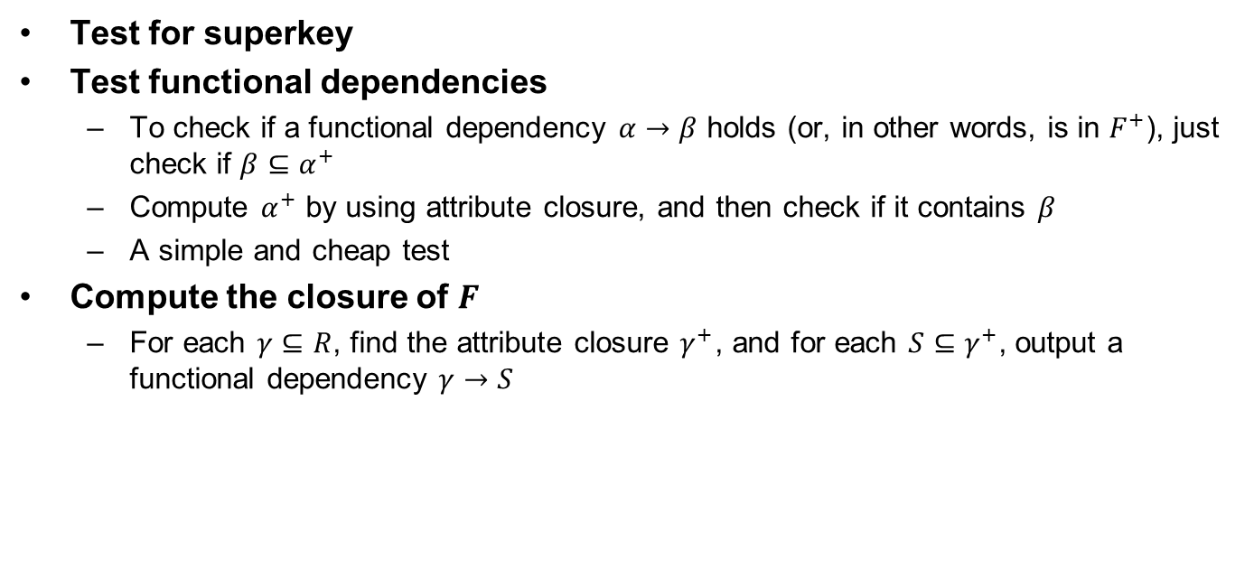
Applications of Attribute Closure
Test for superkey
Test functional dependencies
  To check if a functional dependency $α→β$ holds (or, in other words, is in $F^{+}$), just check if $β⊆α^{+}$
  Compute $α^{+}$ by using attribute closure, and then check if it contains $β$
  A simple and cheap test
Compute the closure of $F$
  For each $γ⊆R$, find the attribute closure $γ^{+}$, and for each $S⊆γ^{+}$, output a functional dependency $γ→S$

Slide 27
Outline
Features of Good Relational Designs
Functional Dependencies
  Decomposition using Functional Dependencies
  Closure of Functional Dependencies
  Closure of Attribute Sets
  Canonical Cover
  Lossless-join Decomposition
  Dependency Preservation
Normalization & Normal Forms (范式)
Multivalued Dependencies*
Database Design Process

Slide 28

Redundancy in FDs
One set of FDs may contain redundant FDs that can be inferred from the others
  e.g., $A→C$ is redundant in: {$A→B$, $B→C$, $A→C$}
  parts of a FD may be redundant
    e.g., on RHS: {$A→B$, $B→C$, $A→CD$} can be simplified to {$A→B$, $B→C$, $A→D$}
    e.g., on LHS: {$A→B$, $B→C$, $AC→D$} can be simplified to {$A→B$, $B→C$, $A→D$}

Slide 29
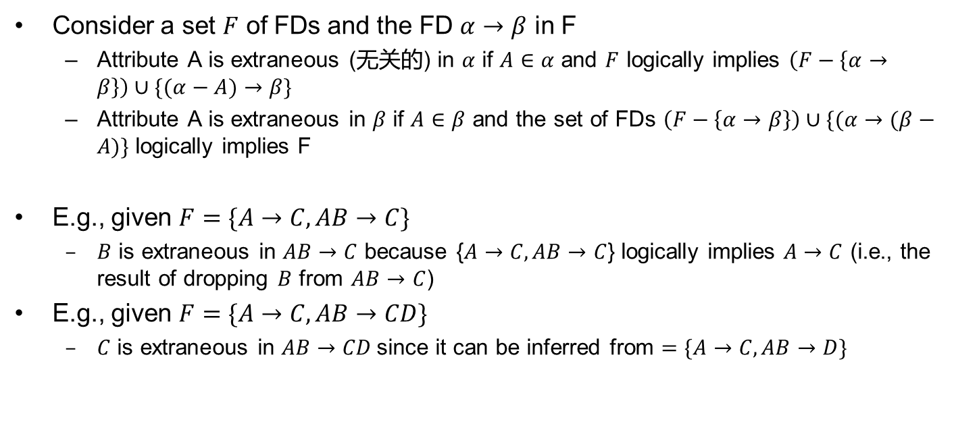
Extraneous Attributes (无关属性)
Consider a set $F$ of FDs and the FD $α→β$ in F
  Attribute A is extraneous (无关的) in $α$ if $A∈α$ and $F$ logically implies $\left(F−\left\{α→β\right\}\right)∪\{(α−A)→β\}$
  Attribute A is extraneous in $β$ if $A∈β$ and the set of FDs $\left(F−\left\{α→β\right\}\right)∪\{(α→(β−A)\}$ logically implies F
E.g., given $F=\{A→C, AB→C\}$
  $B$ is extraneous in $AB→C$ because {$A→C, AB→C$} logically implies $A→C$ (i.e., the result of dropping $B$ from $AB→C$)
E.g., given $F=\{A→C, AB→CD\}$
  $C$ is extraneous in $AB→CD$since it can be inferred from $=\{A→C, AB→D\}$

Slide 30
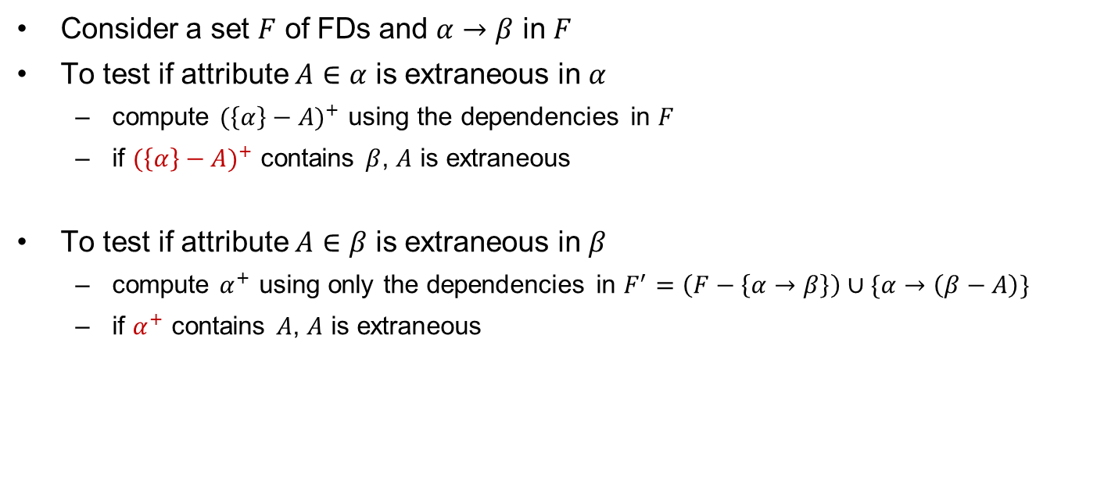
Testing Extraneous Attributes
Consider a set $F$ of FDs and $α→β$ in $F$
To test if attribute $A∈α$ is extraneous in $α$
  compute ${(\left\{α\right\}−A)}^{+}$ using the dependencies in $F$
  if ${(\left\{α\right\}−A)}^{+}$ contains $β$, $A$ is extraneous
To test if attribute $A∈β$ is extraneous in $β$
  compute $α^{+}$ using only the dependencies in $F^{′}=\left(F−\left\{α→β\right\}\right)∪\{α→\left(β−A\right)\}$
  if $α^{+}$ contains $A$, $A$ is extraneous

Slide 31
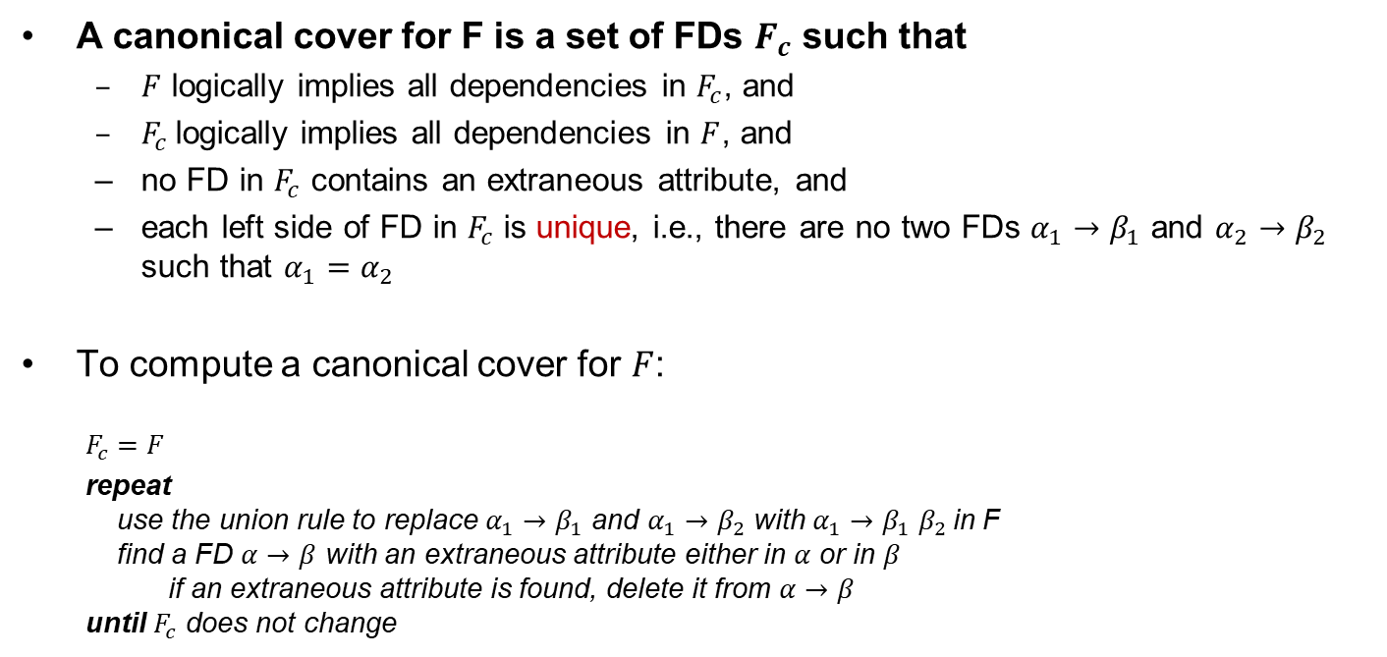
Canonical Cover (正则覆盖)
A canonical cover for F is a set of FDs $F_{c}$ such that
  $F$ logically implies all dependencies in $F_{c}$, and
  $F_{c}$logically implies all dependencies in $F$, and
  no FD in $F_{c}$ contains an extraneous attribute, and
  each left side of FD in $F_{c}$ is unique, i.e., there are no two FDs $α_{1}{→β}_{1}$ and $α_{2}{→β}_{2}$ such that $α_{1}=α_{2}$
To compute a canonical cover for $F$:
  $$F_{c}=F$$
  repeat
  use the union rule to replace $α_{1}{→β}_{1}$ and $α_{1}{→β}_{2}$ with $α_{1}{→β}_{1}β_{2}$in F
  find a FD $α→β$ with an extraneous attribute either in $α$ or in $β$
  if an extraneous attribute is found, delete it from $α→β$
  until $F_{c}$ does not change

Slide 32
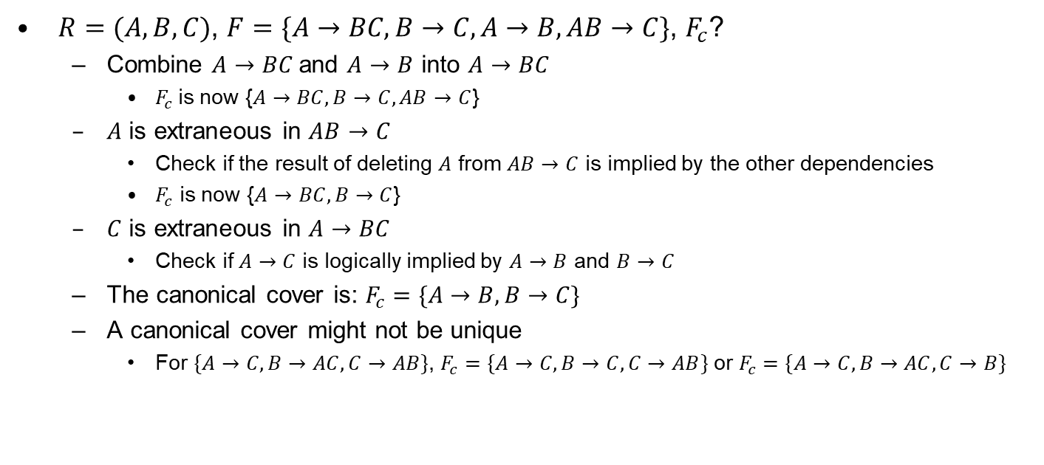
Example of Computing a Canonical Cover
$R=(A,B,C)$, $F=\{A→BC, B→C, A→B, AB→C\}$, $F_{c}$?
  Combine $A→BC$and $A→B$ into $A→BC$
    $F_{c}$is now {$A→BC, B→C, AB→C$}
  $A$ is extraneous in $AB→C$
    Check if the result of deleting $A$ from $AB→C$ is implied by the other dependencies
    $F_{c}$ is now {$A→BC, B→C$}
  $C$ is extraneous in $A→BC$
    Check if $A→C$ is logically implied by $A→B$ and $B→C$
  The canonical cover is: $F_{c}=\{A→B, B→C\}$
  A canonical cover might not be unique
    For $\{A→C, B→AC, C→AB\}$, $F_{c}=\{A→C, B→C, C→AB\}$ or $F_{c}=\{A→C, B→AC, C→B\}$

Slide 33
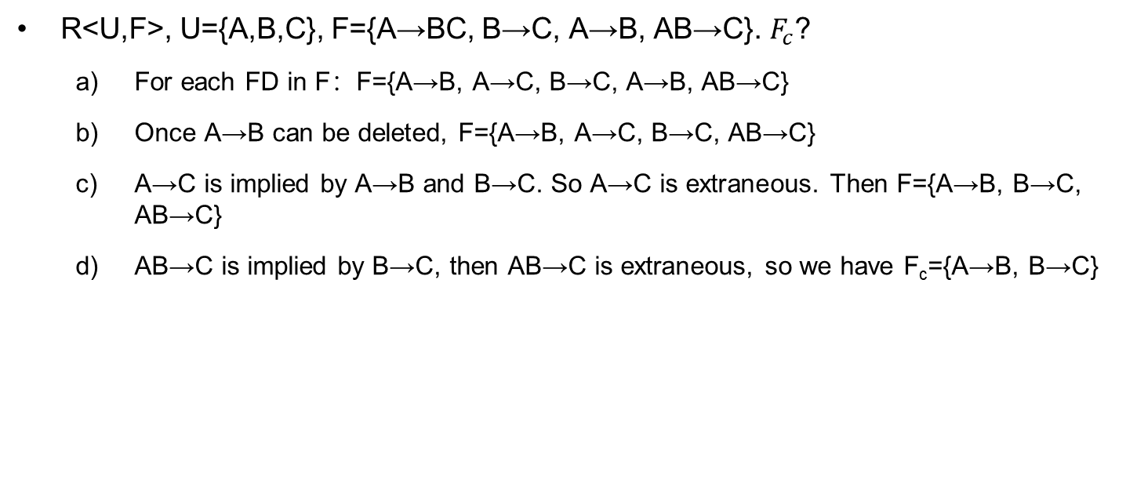
Example of Computing a Canonical Cover
R<U,F>, U={A,B,C}, F={A→BC, B→C, A→B, AB→C}. $F_{c}$?
  For each FD in F：F={A→B, A→C, B→C, A→B, AB→C}
  Once A→B can be deleted, F={A→B, A→C, B→C, AB→C}
  A→C is implied by A→B and B→C. So A→C is extraneous. Then F={A→B, B→C, AB→C}
  AB→C is implied by B→C, then AB→C is extraneous, so we have F_{c}={A→B, B→C}

Slide 34
Example of Computing a Canonical Cover
R<U, F>, U={X, Y, Z, W}, F={W→Y,Y→W, X→WY, Z→WY, XZ→W}, F_{c}?
  (1) F={W→Y, Y→W, X→W, X→Y, Z→W, Z→Y, XZ→W}
  (2) For LHS, F={W→Y, Y→W, X→W, X→Y, Z→W, Z→Y}
  (3) Delete redundant FDs,
  F_{c}={W→Y, Y→W, X→Y, Z→Y} or {W→Y, Y→W, X→W, Z→W}

Slide 35

Find Candidate Keys
For $H(A_{1},A_{2},…,A_{n})$ and FDs in $F$, all attributes can be classified into 4 types：
  L：only exists in LHS
  R：only exists in RHS
  N：not exists in either LHS or RHS
  LR：exists in both LHS and RHS

Slide 36
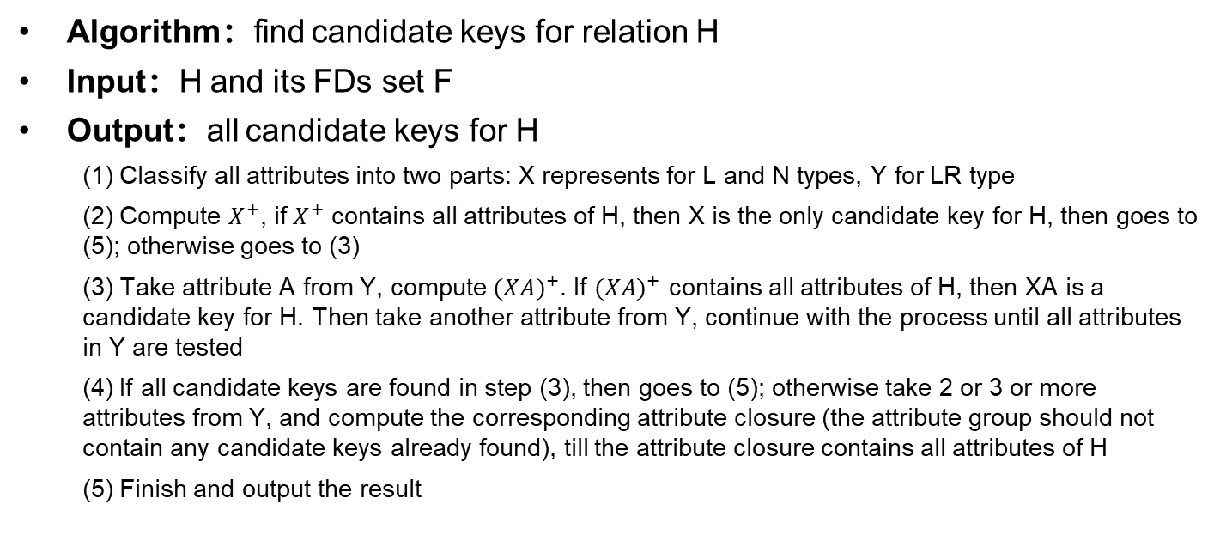
Find Candidate Keys (Cont.)
Algorithm：find candidate keys for relation H
Input：H and its FDs set F
Output：all candidate keys for H
  (1) Classify all attributes into two parts: X represents for L and N types, Y for LR type
  (2) Compute $X^{+}$, if $X^{+}$ contains all attributes of H, then X is the only candidate key for H, then goes to (5); otherwise goes to (3)
  (3) Take attribute A from Y, compute ${(XA)}^{+}$. If ${(XA)}^{+}$ contains all attributes of H, then XA is a candidate key for H. Then take another attribute from Y, continue with the process until all attributes in Y are tested
  (4) If all candidate keys are found in step (3), then goes to (5); otherwise take 2 or 3 or more attributes from Y, and compute the corresponding attribute closure (the attribute group should not contain any candidate keys already found), till the attribute closure contains all attributes of H
  (5) Finish and output the result

Slide 37
Find Candidate Keys (Cont.)
Given R<U, F>, U={X, Y, Z, W}, and F={W→Y, Y→W, X→WY, Z→WY, XZ→W}, find all candidate keys of R
  F_{c}={W→Y, Y→W, X→Y, Z→Y}
  X_{LN}=X_{L}=XZ，Y_{LR}=YW
  X_{LN}⁺={X,Y,Z,W}=U，so (XZ) is the only candidate key of R

Slide 38
Find Candidate Keys (Cont.)
Given R<U,F>, U={A,B,C,D}, and F={AB→C, C→D, D→A}, find all candidate keys of R
  F_{c}={AB→C, C→D, D→A}
  X_{LN}=X_{L}=B，Y_{LR}=ACD
  X_{LN}⁺={B}≠U
  (AB)⁺={ABCD}=U, (BC)⁺={ABCD}=U, (BD)⁺={ABCD}=U, then (AB)、(BC)、(BD) are all candidate keys of R

Slide 39
Find Candidate Keys (Cont.)
Given R<U,F>, U={OBISQD}, F={S→D, D→S, I→B, B→I, B→O, O→B}, find all candidate keys of R
  (1) F_{c}= { ？}
  (2) X_{LN}= ？，Y_{LR}= ？
  (3) X_{LN}⁺={ ？}
  (4) …

Slide 40
Find Candidate Keys (Cont.)
Given R<U,F>, U={OBISQD}, F={S→D, D→S, I→B, B→I, B→O, O→B}, find all candidate keys of R
  (1) F_{c}={S→D, D→S, I→B, B→IO, O→B}
  (2) X_{LN}= Q，Y_{LR}= SDBIO
  (3) X_{LN}⁺={Q} ≠U
  (4)(QS)⁺={QSD}, (QD)⁺={QSD}, (QB)⁺={QBIO}, (QI)⁺={QBIO}, (QO)⁺={QBIO}; ≠U
  (QSO)⁺、(QSB)⁺、(QSI)⁺、(QSD)⁺ 、(QDO)⁺、(QDB)⁺、(QDI)⁺ 、(QDS)⁺、
  (QBO)⁺、(QBI)⁺、(QBS)⁺、(QBD)⁺ 、(QIO)⁺、(QIB)⁺、(QSI)⁺、(QID)⁺ 、
  (QOB)⁺、(QOI)⁺、(QOS)⁺、(QOD)⁺ …
  candidate keys of R:
  (QSO)、(QDO)、(QSB)、(QDB)、(QSI)、(QDI)

Slide 41
Outline
Features of Good Relational Designs
Functional Dependencies
  Decomposition using Functional Dependencies
  Closure of Functional Dependencies
  Closure of Attribute Sets
  Canonical Cover
  Lossless-join Decomposition
  Dependency Preservation
Normalization & Normal Forms (范式)
Multivalued Dependencies*
Database Design Process

Slide 42
Decomposition
in_dep_schema (ID, name, salary, dept_name, building, budget)
Decompose the relation schema in_dep_schema into two relations:
  instructor(ID, name, salary, dept_name)
  department(dept_name, building, budget)

Slide 43
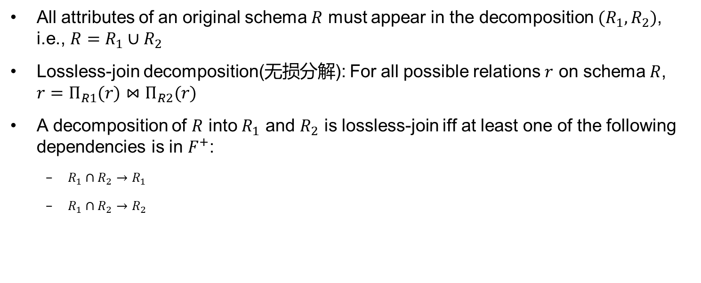
Decomposition
All attributes of an original schema $R$ must appear in the decomposition $(R_{1},R_{2})$, i.e., $R=R_{1}∪R_{2}$
Lossless-join decomposition(无损分解): For all possible relations $r$ on schema $R$, $r=Π_{R1}(r)⋈Π_{R2}(r)$
A decomposition of $R$ into $R_{1}$ and $R_{2}$ is lossless-join iff at least one of the following dependencies is in $F^{+}$:
  $R_{1}∩R_{2}→R_{1}$
  $R_{1}∩R_{2}→R_{2}$

Slide 44
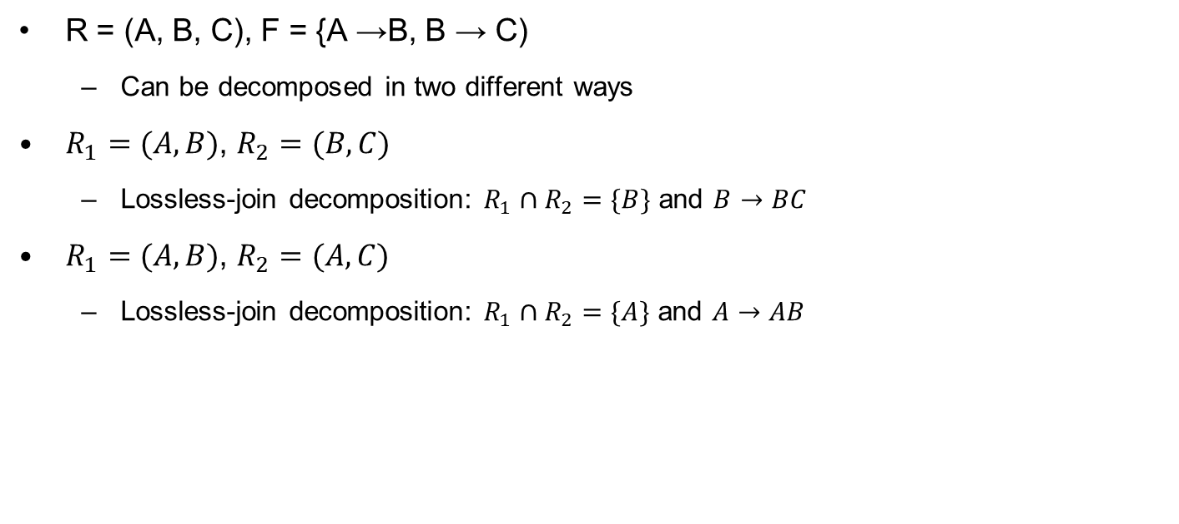
Example
R = (A, B, C), F = {A →B, B → C)
  Can be decomposed in two different ways
$R_{1}=(A,B)$, $R_{2}=(B,C)$
  Lossless-join decomposition: $R_{1}∩R_{2}=\{B\}$ and $B→BC$
$R_{1}=(A,B)$, $R_{2}=(A,C)$
  Lossless-join decomposition: $R_{1}∩R_{2}=\{A\}$ and $A→AB$

Slide 45
Example
Given R<U,F>, U={A,B,C,D,E}, F={AB→C, C→D, D→E}, and a decomposition ρ of R into:
  R₁(A,B,C), R₂(C,D), R₃(D,E)
  Is ρ a lossless-join decomposition or a lossy one?

Slide 46
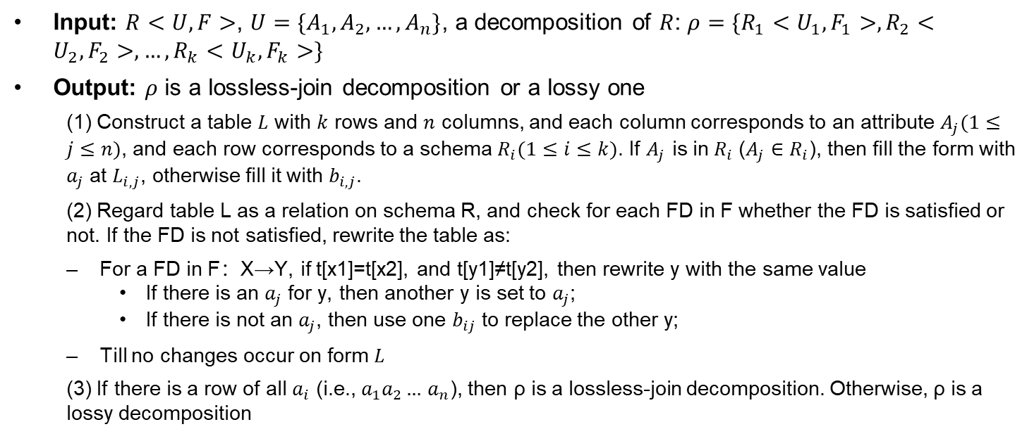
Test for Lossless-join Decomposition
Input: $R<U,F>$, $U=\{A_{1},A_{2},…,A_{n}\}$, a decomposition of $R$: $ρ=\{R_{1}<U_{1},F_{1}>,R_{2}<U_{2},F_{2}>,…,R_{k}<U_{k},F_{k}>\}$
Output: $ρ$ is a lossless-join decomposition or a lossy one
  (1) Construct a table $L$ with $k$ rows and $n$ columns, and each column corresponds to an attribute $A_{j}(1≤j≤n)$, and each row corresponds to a schema $R_{i}(1≤i≤k)$. If $A_{j}$ is in $R_{i}$ (${A_{j}∈R}_{i}$), then fill the form with $a_{j}$ at $L_{i,j}$, otherwise fill it with $b_{i,j}$.
  (2) Regard table L as a relation on schema R, and check for each FD in F whether the FD is satisfied or not. If the FD is not satisfied, rewrite the table as:
  For a FD in F：X→Y, if t[x1]=t[x2], and t[y1]≠t[y2], then rewrite y with the same value
    If there is an $a_{j}$ for y, then another y is set to $a_{j}$;
    If there is not an $a_{j}$, then use one $b_{ij}$ to replace the other y;
  Till no changes occur on form $L$
  (3) If there is a row of all $a_{i}$ (i.e., $a_{1}a_{2}…$ $a_{n}$), then ρ is a lossless-join decomposition. Otherwise, ρ is a lossy decomposition

Slide 47
Example
Given R<U, F>, U={A, B, C, D, E}, F={AB→C, C→D, D→E}, and a decomposition ρ of R into: R₁(A, B, C), R₂(C, D), R₃(D, E). Is ρ a lossless-join decomposition or a lossy one?
(1) First, construct a table as:
 | A | B | C | D | E
R₁(A,B,C) | a₁ | a₂ | a₃ | b₁₄ | b₁₅
R₂(C,D) | b₂₁ | b₂₂ | a₃ | a₄ | b₂₅
R₃(D,E) | b₃₁ | b₃₂ | b₃₃ | a₄ | a₅

Slide 48

Example (cont.)
(2) For AB→C in F, no change occurs; for C→D, rewrite $b_{14}$ with $a_{4}$, and for D→E, rewrite $b_{15}$ and $b_{25}$ as $a_{5}$. Then we have a row as: $a_{1}$, $a_{2}$, $a_{3}$, $a_{4}$, $a_{5}$. The decomposition of R into R₁, R₂, and R₃ is a lossless-join one.
 | A | B | C | D | E
R₁(A,B,C) | a₁ | a₂ | a₃ | _{B14} a₄ | _{b15} a₅
R₂(C,D) | b₂₁ | b₂₂ | a₃ | a₄ | _{b25} a₅
R₃(D,E) | b₃₁ | b₃₂ | b₃₃ | a₄ | a₅

Slide 49
More Examples
R<U,F>, U={A,B,C,D,E}, F={A→C, B→C, C→D, DE→C, CE→A}, and a decomposition of R: ρ={R₁(A,D), R₂(A,B), R₃(B,E), R₄(C,D,E), R₅(A,E)}. ρ is a lossless-join decomposition or a lossy one ?
  ρ is a lossless-join decomposition
R<U,F>, U={A,B,C,D}, F={A→B, A→C, C→D}, ρ={R₁(A,B), R₂(B,C), R₃(C,D)}. ρ is a lossless-join decomposition or a lossy one?
  ρ is a lossy-join decomposition

Slide 50
More Examples
R<U,F>, U={A,B,C,D,E}, F={A→C, B→C, C→D, DE→C, CE→A}, and a decomposition of R: ρ={R₁(A,D), R₂(A,B), R₃(B,E), R₄(C,D,E), R₅(A,E)}. ρ is a lossless-join decomposition or a lossy one ?
  ρ is a lossless-join decomposition
 | A | B | C | D | E
R₁ | a1 | b12→a2 | b13 | a4 | b15→a5
R₂ | a1 | a2 | b23→b13 | b24→a4 | b25→a5
R₃ | b31→a1 | a2 | b33→b13→a3 | b34→a4 | a5
R₄ | b41→a1 | b42 | a3 | a4 | a5
R₅ | a1 | b52→a2 | b53→b13→a3 | b54→a4 | a5

Slide 51
More Examples
R<U,F>, U={A,B,C,D}, F={A→B, A→C, C→D}, ρ={R₁(A,B), R₂(B,C), R₃(C,D)}. ρ is a lossless-join decomposition or a lossy one?
  ρ is a lossy-join decomposition
 | A | B | C | D
R₁ | a₁ | a₂ | b₁₃ | b₁₄
R₂ | b₂₁ | a₂ | a₃ | b₂₄a₄
R₃ | b₃₁ | b₃₂ | a₃ | a₄

Slide 52
Outline
Features of Good Relational Designs
Functional Dependencies
  Decomposition using Functional Dependencies
  Closure of Functional Dependencies
  Closure of Attribute Sets
  Canonical Cover
  Lossless-join Decomposition
  Dependency Preservation
Normalization & Normal Forms (范式)
Multivalued Dependencies*
Database Design Process

Slide 53
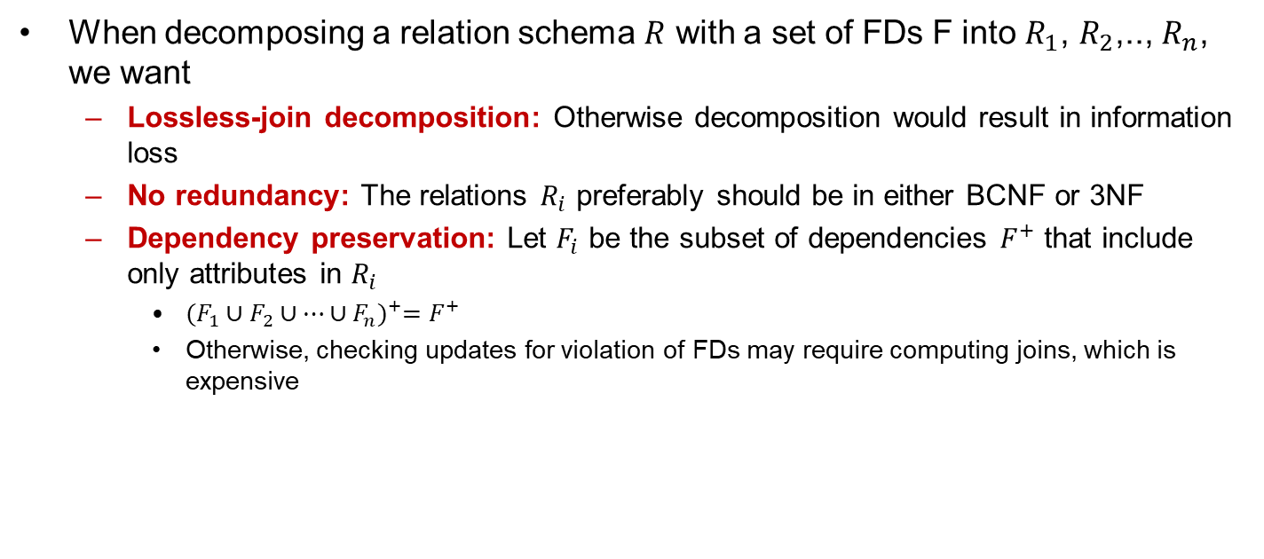
Goal of Decomposition
When decomposing a relation schema $R$ with a set of FDs F into $R_{1}$, $R_{2}$,.., $R_{n}$, we want
  Lossless-join decomposition: Otherwise decomposition would result in information loss
  No redundancy: The relations $R_{i}$ preferably should be in either BCNF or 3NF
  Dependency preservation: Let $F_{i}$ be the subset of dependencies $F^{+}$ that include only attributes in $R_{i}$
    ${(F_{1}∪F_{2}∪…∪F_{n})}^{+}=F^{+}$
    Otherwise, checking updates for violation of FDs may require computing joins, which is expensive

Slide 54
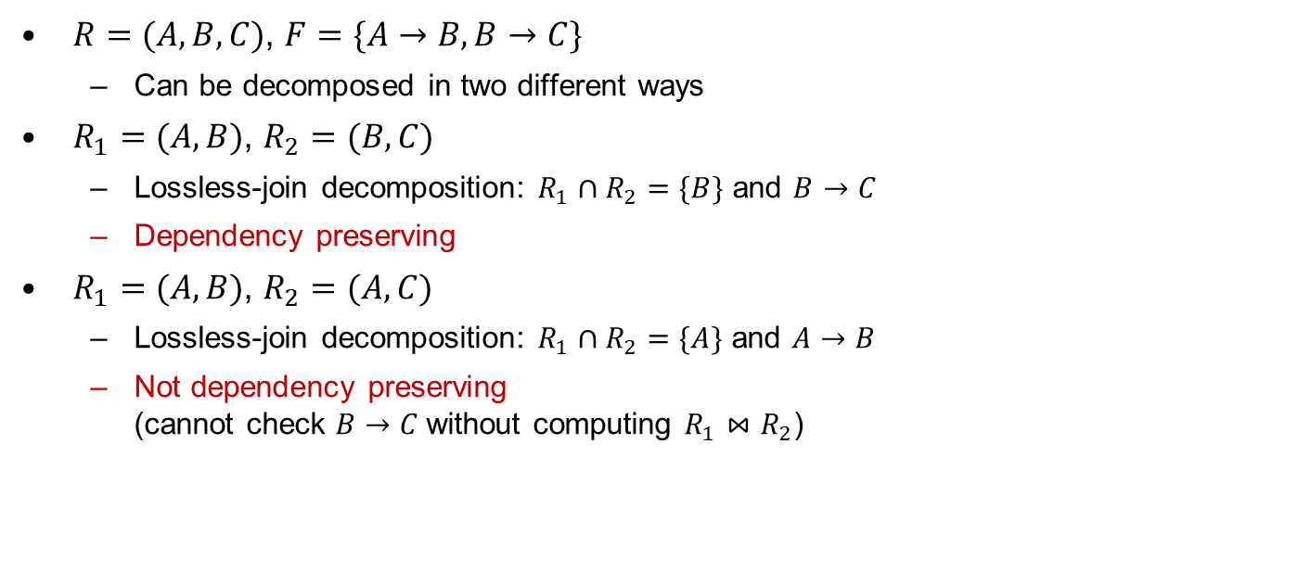
Example
$R=(A,B,C)$, $F=\{A→B,B→C\}$
  Can be decomposed in two different ways
$R_{1}=(A,B)$, $R_{2}=(B,C)$
  Lossless-join decomposition: $R_{1}∩R_{2}=\{B\}$ and $B→C$
  Dependency preserving
$R_{1}=(A,B)$, $R_{2}=(A,C)$
  Lossless-join decomposition: $R_{1}∩R_{2}=\{A\}$ and $A→B$
  Not dependency preserving
  (cannot check $B→C$without computing $R_{1}⋈R_{2}$)

Slide 55
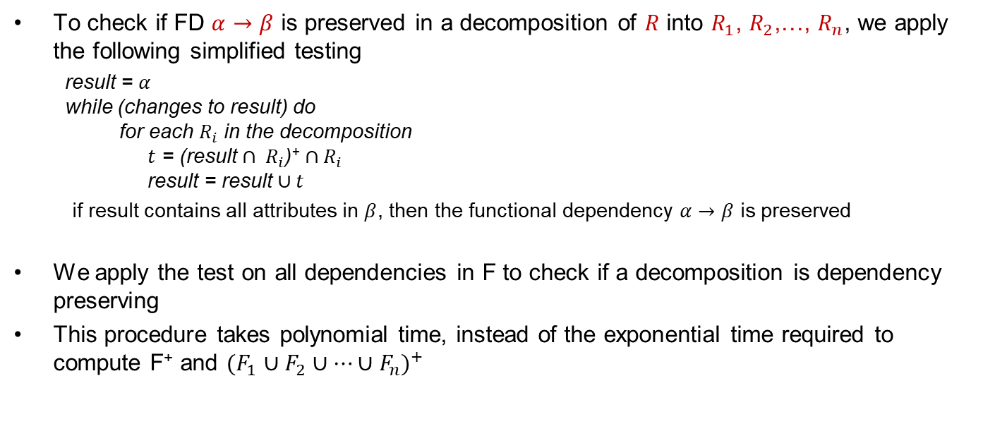
Testing for Dependency Preservation
To check if FD $α→β$ is preserved in a decomposition of $R$ into $R_{1}$, $R_{2}$,…, $R_{n}$, we apply the following simplified testing
result = $α$
while (changes to result) do
for each $R_{i}$ in the decomposition
$t$ = (result $∩ R_{i}$)⁺ $∩R_{i}$
result = result $∪t$
  if result contains all attributes in $β$, then the functional dependency $α→β$ is preserved
We apply the test on all dependencies in F to check if a decomposition is dependency preserving
This procedure takes polynomial time, instead of the exponential time required to compute F⁺ and ${(F_{1}∪F_{2}∪…∪F_{n})}^{+}$
Notes:
保持依赖测试：用依赖关系中的左侧属性a滚动各个关系合并可决定的属性，最后检查是否包含b中所有属性

Slide 56
Outline
Features of Good Relational Designs
Functional Dependencies
  Decomposition using Functional Dependencies
  Closure of Functional Dependencies
  Closure of Attribute Sets
  Canonical Cover
  Lossless-join Decomposition
  Dependency Preservation
Normalization & Normal Forms (范式)
Multivalued Dependencies*
Database Design Process

Slide 57
Data Normalization (规范化)
Normalization: The process of decomposing relations with anomalies to
  produce smaller and well-structured relations
  validate and improve a logical design so that it satisfies certain constraints that avoid unnecessary duplication of data
The problems of having duplication of data
  Waste of space
  Difficulty in consistency control

Slide 58
Well-structured Relations
A relation that contains minimal data redundancy and allows users to insert, delete, and update rows without causing data inconsistencies
Goal is to avoid anomalies
  Insertion anomaly – adding new rows forces user to create duplicate data
  Deletion anomaly – deleting rows may cause a loss of data that would be needed for other future rows
  Modification anomaly – changing data in a row forces changes to other rows because of duplication

Slide 59
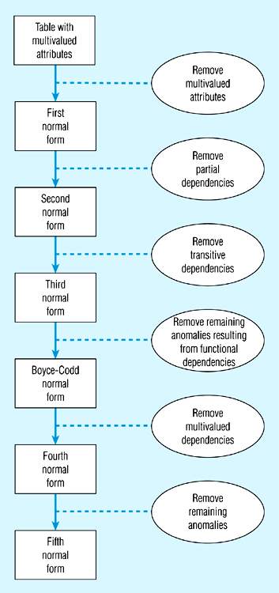
Steps in Normalization
Notes:
BC范式到第四范式是去除了一些非平凡的多值依赖，并非完全去除多值依赖

Slide 60
Atomic Domains and 1st Normal Form
Domain is atomic if its elements are considered to be indivisible units
  attributes do not have any substructures
A relational schema R is in 1NF if the domains of all attributes of R are atomic
Non-atomic values complicate storage and result in redundant storage of data
  E.g., composite attribute/ multivalued attributes

Slide 61
First Normal Form (Cont.)
Atomicity (原子性) is actually a property of how the elements of the domain are used
  E.g., strings would normally be considered indivisible
    Suppose that students are given roll numbers which are strings of the form 0372001
    If the first four characters are extracted to identify the department, the domain of roll numbers is not atomic
      Doing so is a bad idea: lead to encoding of information in application program rather than in the database

Slide 62
First Normal Form (1NF)
Requirements
  No multivalued attributes
  Every attribute value is atomic
E.g.,
  Table 1 is not in 1st Normal Form (multivalued attributes)
  Table 2 is in 1st Normal form
All relations are in 1st Normal Form

Slide 63
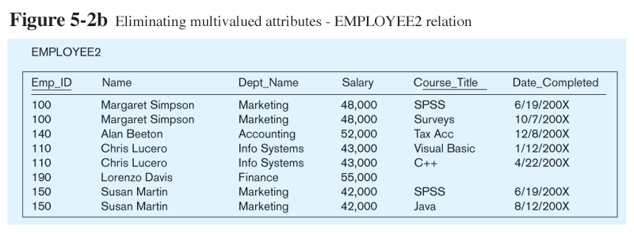
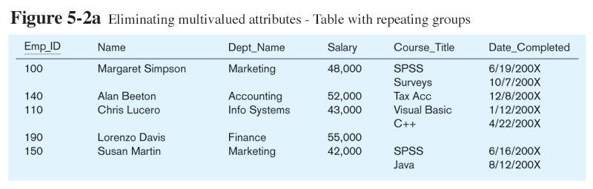
Table 1
Table 2

Slide 64
Second Normal Form
2nd Normal Form
  1NF
  Every non-key attribute is fully functionally dependent on the Entire primary key, i.e., no partial functional dependencies
Partial functional dependency
  A function dependency in which one or more non-key attributes are functionally dependent on part (but not all) of the primary key

Slide 65
Functional Dependencies in Employee
Dependency on the entire primary key
EmpID
CourseTitle
Name
DeptName
Salary
DateCompleted
Dependency on only part of the primary key
EmpID, CourseTitle ➔ DateCompleted
EmpID ➔ Name, DeptName, Salary
As such, NOT in 2nd Normal Form!

Slide 66
Decompose a Relation to 2nd Normal Form
Decompose the relation into two separate relations
Both are full functional dependencies
Emp_t
EmpID
Name
DeptName
Salary
Emp_Course_t
EmpID
CourseTitle
DateCompleted

Slide 67
Third Normal Form
Requirements
  2NF
  No transitive dependencies
A transitive dependency is a functional dependency between two (or more) non-key attributes

Slide 68
Relation with Transitive Dependency
Cust_ID | Name | Salesperson | Region
8023 | Anderson | Smith | South
9167 | Bancroft | Hicks | West
7924 | Hobbs | Smith | South
6837 | Tucker | Hernandez | East
8596 | Eckersley | Hicks | West
7018 | Arnold | Faulb | North
Sales relation

Slide 69
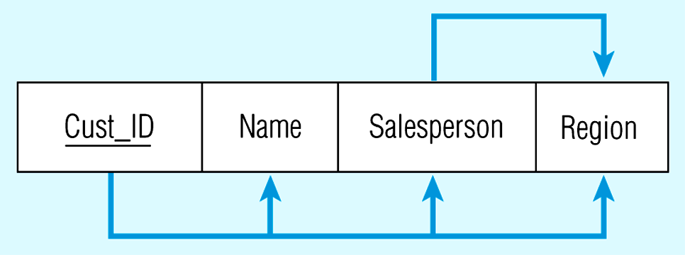
Relation with Transitive Dependency
Cust_ID → Name
Cust_ID → Salesperson
Cust_ID → Region
(2nd NF)
BUT
Cust_ID → Salesperson → Region
Transitive dependency
(not 3rd NF)

Slide 70
Relation with Transitive Dependency
Cust_ID | Name | Salesperson
8023 | Anderson | Smith
9167 | Bancroft | Hicks
7924 | Hobbs | Smith
6837 | Tucker | Hernandez
8596 | Eckersley | Hicks
7018 | Arnold | Faulb
Salesperson | Region
Smith | South
Hicks | West
Hernandez | East
Faulb | North
Sales_new
Salesperson
Decompose the Sales relation

Slide 71
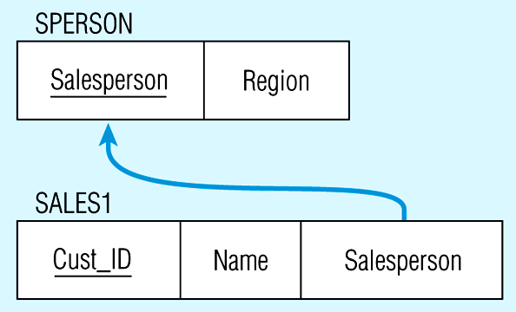
Relations in 3NF
Salesperson → Region
Cust_ID → Name
Cust_ID → Salesperson
Now, there are no transitive dependencies…
Both relations are in 3NF

Slide 72
Data Normalization
1st Normal Form
  No multivalued attributes, and every attribute value is atomic
  All relations are in 1st Normal Form
2nd Normal Form
  1NF + every non-key attribute is fully functionally dependent on the ENTIRE primary key
3rd Normal Form
  2NF + no transitive dependency
Boyce-Codd NF
  All determinants (决定属性) are superkeys
4th NF
  No multivalued dependencies
5th NF
  投影-连接范式（project-join normal from, PJNF）
  Minimize redundancy by separating semantically connected relationships

Slide 73

Boyce-Codd Normal Form
Given relation schema R and FDs F, R is in BCNF if at least one of the following condition holds for every FD $α→β$ in F⁺:
  $α→β$ is trivial (i.e., $β⊆α$)
  $α$ is a superkey for R
Notes:
“决定属性”(Determinant)
BCNF是指关系表中，主要功能依赖A→B的左边属性A称为“决定属性”(Determinant)，决定属性一定是候选键或主键。如果关系表拥有不符合上述规则的功能依赖，就表示有不同的数据储存在同一个关系表，需要分割关系表

Slide 74
Example
R = (A, B, C), F = {A → B, B → C }, Key = {A}
  R is not in BCNF since B → C but B is not the key
Decomposition R₁ = (A, B), R₂ = (B, C)
  R₁ and R₂ in BCNF
  Lossless-join decomposition
  Dependency preserving

Slide 75
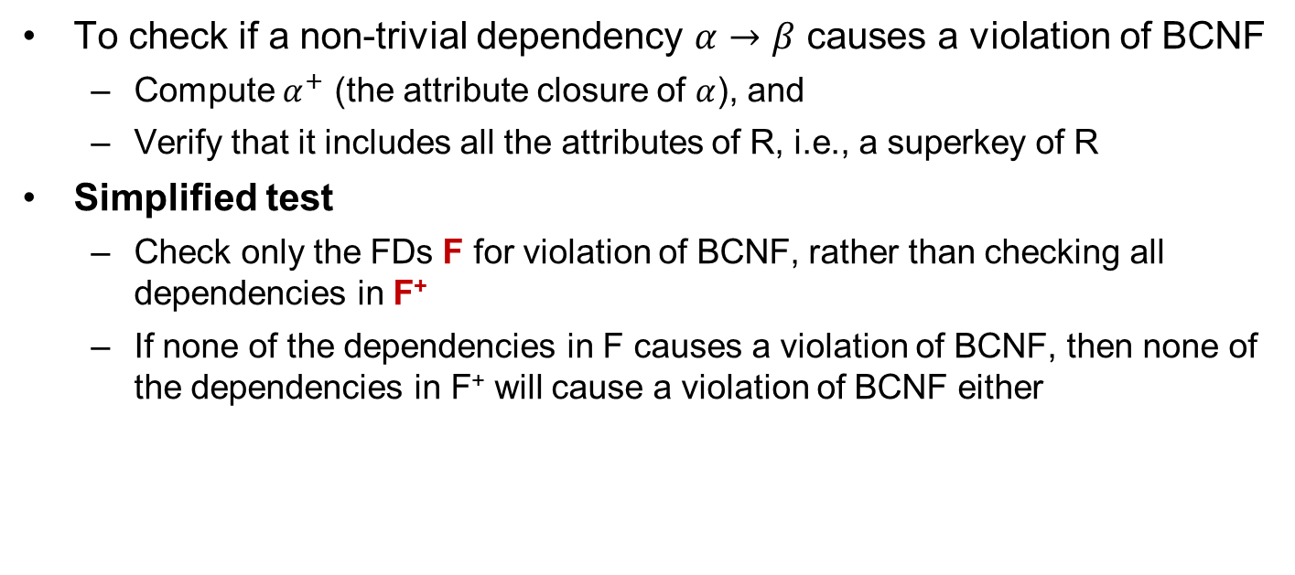
Testing for BCNF
To check if a non-trivial dependency $α→β$ causes a violation of BCNF
  Compute $α^{+}$ (the attribute closure of $α$), and
  Verify that it includes all the attributes of R, i.e., a superkey of R
Simplified test
  Check only the FDs F for violation of BCNF, rather than checking all dependencies in F⁺
  If none of the dependencies in F causes a violation of BCNF, then none of the dependencies in F⁺ will cause a violation of BCNF either

Slide 76
Testing for BCNF (Cont.)
Checking only F is incorrect when testing a relation in a decomposition of R
  E.g., consider R(A, B, C, D) with F = {A → B, B → C}
    Decompose R into R₁(A,B) and R₂(A,C,D)
    Neither of the dependencies in F contain only attributes from (A,C,D) and we might be mislead into thinking that R₂ satisfies BCNF
    However, dependency A → C in F⁺ shows that R₂ is not in BCNF
Notes:
只用F测试是否BCNF是可以的，但用来判断分解后子模式是否是BCNF就不够了

Slide 77
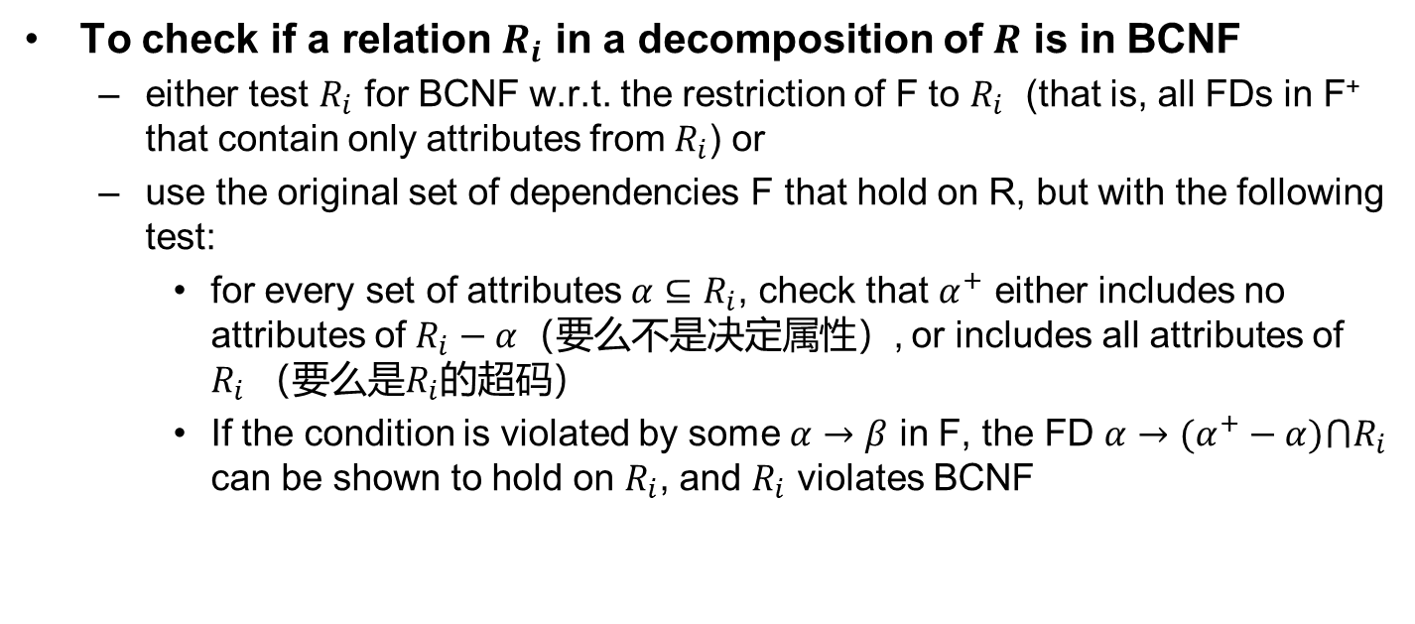
Testing Decomposition for BCNF
To check if a relation $R_{i}$ in a decomposition of $R$ is in BCNF
  either test $R_{i}$ for BCNF w.r.t. the restriction of F to $R_{i}$ (that is, all FDs in F⁺ that contain only attributes from $R_{i}$) or
  use the original set of dependencies F that hold on R, but with the following test:
    for every set of attributes $α⊆R_{i}$, check that $α^{+}$ either includes no attributes of $R_{i}−α$（要么不是决定属性）, or includes all attributes of $R_{i}$（要么是$R_{i}$的超码）
    If the condition is violated by some $α→β$ in F, the FD $α→(α^{+}−α)⋂R_{i}$ can be shown to hold on $R_{i}$, and $R_{i}$ violates BCNF

Slide 78
BCNF Decomposition Algorithm
result := {R};
done := false;
compute F⁺;
while (not done) do
if (there is a schema R_{i} in result that is not in BCNF)
then begin
let α→β be a non-trivial FD that holds on R_{i}
such that α→R_{i} is not in F⁺, and α∩β = ∅;
result := (result – R_{i}) ∪ (R_{i} – β) ∩ (α, β);
end
else done := true;
Note: each R_{i} is in BCNF, and the decomposition is lossless-join.
Notes:
(R_{i} – β) ∩ (α, β )=α，α→β，说明分解无损。请参考ppt 43页

Slide 79
Example
Consider the relation scheme {C, T, H, R, S, G}, where C=course, T=teacher, H=hour, R=room, S=student, and G=grade.
The functional dependencies F are:
  CS→G: each student has one grade in each course
  C→T: each course has one teacher
  HR→C: only one course can meet in a room at one time
  HS→R: a student can be in only one room at one time
  TH→R: a teacher can be in only one room at one time

Slide 80
Decomposition Tree
CTHRSG
Key=HS
CS→G C→T
HR→C HS→R
TH→R
CTHRS
Key=HS
C→T
HR→C HS→R
TH→R
CSG
Key=CS
CS→G
CHRS
Key=HS
HR→C HS→R
CH→R
CT
Key=C
C→T
HSR
Key=HS
HS→R
CHR
Key=HR或CH
HR→C或CH→R
or
CHS
Key=HS
HS→C

Slide 81
BCNF and Dependency Preservation
It is not always possible to get a BCNF decomposition that is dependency preserving
R = (J, K, L), F = {JK → L, L → K}, two candidate keys = JK and JL
  R is not in BCNF
Any decomposition of R will fail to preserve
  JK → L 或者 L → K
Notes:
无损分解：对
保持依赖：不对。这里的例子：LK,JL

Slide 82
Third Normal Form: Motivation
There are some situations where
  BCNF decomposition is not dependency preserving
  Efficient checking for FD violation on updates is important
Solution: define a weaker normal form, i.e., Third Normal Form
  Allow some redundancy
  But FDs can be checked on individual relations without computing a join
  There is always a lossless-join and dependency-preserving decomposition into 3NF
Notes:
是否无损用表格法，是否函数依赖保持用代码检验

Slide 83
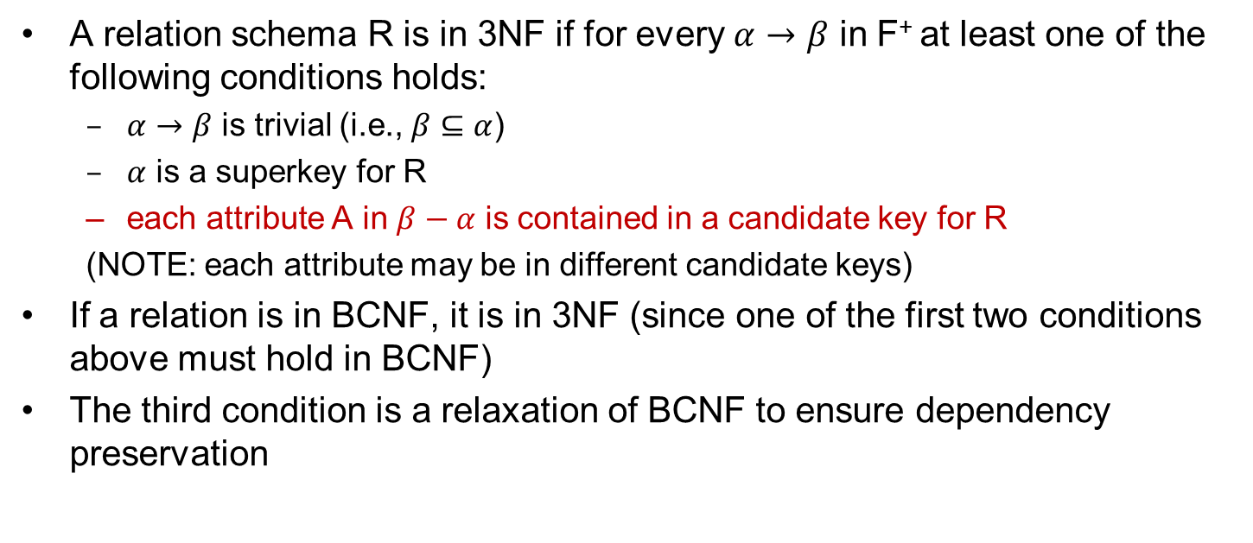
Third Normal Form
A relation schema R is in 3NF if for every $α→β$ in F⁺ at least one of the following conditions holds:
  $α→β$ is trivial (i.e., $β⊆α$)
  $α$ is a superkey for R
  each attribute A in $β−α$ is contained in a candidate key for R
  (NOTE: each attribute may be in different candidate keys)
If a relation is in BCNF, it is in 3NF (since one of the first two conditions above must hold in BCNF)
The third condition is a relaxation of BCNF to ensure dependency preservation
Notes:
Each attr. A in β – α is contained in a candidate key for R.意思是，如果α→β 中α不是candidate keys,那么如果β – α 是主属性则是3NF，否则不是。而BCNF即使β – α 是主属性也不行，α必须是超键。

Slide 84
3NF (Cont.)
Example
  R = (J, K, L), F = {JK → L, L → K}, two candidate keys: JK and JL
  R is in 3NF
    JK → L JK is a superkey
    L → K K is contained in a candidate key
There is some redundancy in this schema
Equivalent to example:
  banker-schema = (branch_name, customer_name, banker_name)
  banker_name → branch_name
  branch_name, customer_name → banker_name

Slide 85
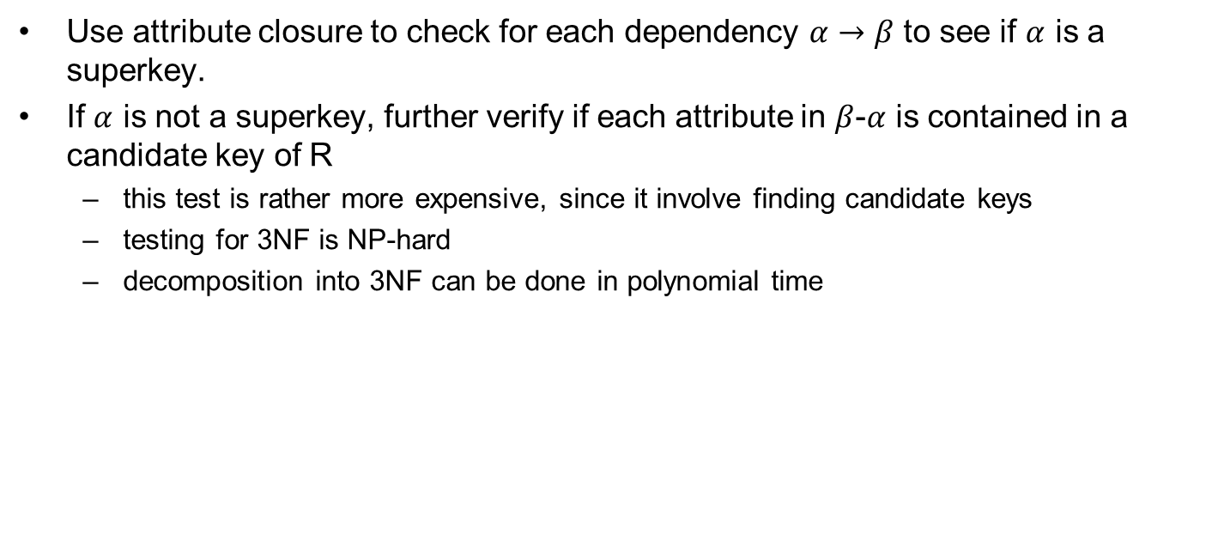
Testing for 3NF
Use attribute closure to check for each dependency $α→β$ to see if $α$ is a superkey.
If $α$ is not a superkey, further verify if each attribute in $β$-$α$ is contained in a candidate key of R
  this test is rather more expensive, since it involve finding candidate keys
  testing for 3NF is NP-hard
  decomposition into 3NF can be done in polynomial time

Slide 86
3NF Decomposition Algorithm
Let F_{c} be a canonical cover for F;
i := 0;
for each FD α→β in F_{c} do
i := i + 1;
R_{i} := α β
if none of the schemas R_{j}, 1 ≤ j ≤ i contains a candidate key for R
i := i + 1;
R_{i} := any candidate key for R;
return (R₁, R₂, ..., R_{i})
The algorithm ensures that each relation schema $R_{i}$ is in 3NF, and the decomposition is dependency preserving and lossless-join

Slide 87
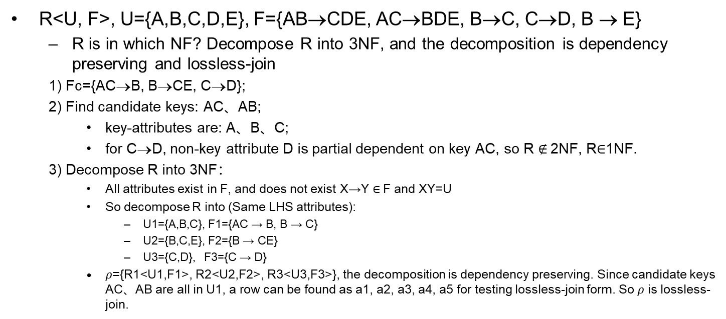
3NF Decomposition Example 1
R<U, F>, U={A,B,C,D,E}, F={AB→CDE, AC→BDE, B→C, C→D, B → E}
  R is in which NF? Decompose R into 3NF, and the decomposition is dependency preserving and lossless-join
  1) Fc={AC→B, B→CE, C→D};
  2) Find candidate keys: AC、AB;
    key-attributes are: A、B、C;
    for C→D, non-key attribute D is partial dependent on key AC, so R $∉$2NF, R$∈$1NF.
  3) Decompose R into 3NF：
    All attributes exist in F, and does not exist X→Y $∈$F and XY=U
    So decompose R into (Same LHS attributes):
      U1={A,B,C}, F1={AC → B, B → C}
      U2={B,C,E}, F2={B → CE}
      U3={C,D}, F3={C → D}
    $ρ$={R1<U1,F1>, R2<U2,F2>, R3<U3,F3>}, the decomposition is dependency preserving. Since candidate keys AC、AB are all in U1, a row can be found as a1, a2, a3, a4, a5 for testing lossless-join form. So $ρ$ is lossless-join.

Slide 88
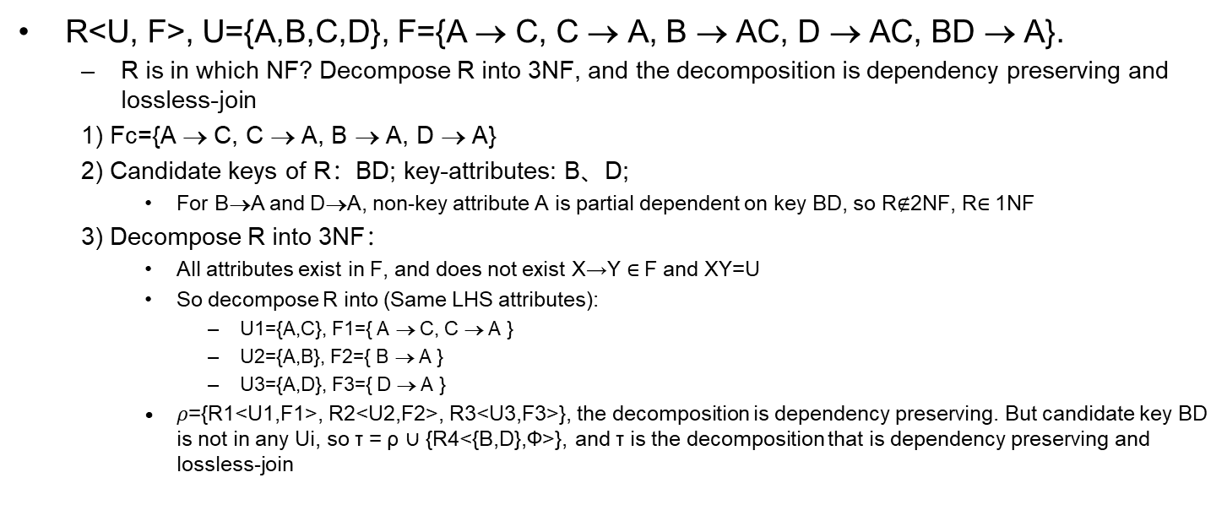
3NF Decomposition Example 2
R<U, F>, U={A,B,C,D}, F={A → C, C → A, B → AC, D → AC, BD → A}.
  R is in which NF? Decompose R into 3NF, and the decomposition is dependency preserving and lossless-join
  1) Fc={A → C, C → A, B → A, D → A}
  2) Candidate keys of R：BD; key-attributes: B、D;
    For B→A and D→A, non-key attribute A is partial dependent on key BD, so R$∉$2NF, R$∈$1NF
  3) Decompose R into 3NF：
    All attributes exist in F, and does not exist X→Y $∈$F and XY=U
    So decompose R into (Same LHS attributes):
      U1={A,C}, F1={ A → C, C → A }
      U2={A,B}, F2={ B → A }
      U3={A,D}, F3={ D → A }
    $ρ$={R1<U1,F1>, R2<U2,F2>, R3<U3,F3>}, the decomposition is dependency preserving. But candidate key BD is not in any Ui, so τ = ρ $∪$ {R4<{B,D},Φ>}, and τ is the decomposition that is dependency preserving and lossless-join

Slide 89
Example
Relation schema:
  banker-info-schema = (branch-name, customer-name, banker-name, office-number)
The FDs for this relation schema are:
  banker-name → branch-name, office-number
  customer-name, branch-name → banker-name
The key is:
  {customer-name, branch-name}

Slide 90
Applying 3NF to banker-info-schema
The for loop in the algorithm causes us to include the following schemas in our decomposition:
  banker-office-schema = (banker-name, branch-name, office-number)
  banker-schema = (customer-name, branch-name, banker-name)
Since banker-schema contains a candidate key for
banker-info-schema, we are done with the decomposition process

Slide 91
Comparison of BCNF and 3NF
It is always possible to decompose a relation into relations in 3NF and
  the decomposition is lossless-join
  the dependencies are preserved
It is always possible to decompose a relation into relations in BCNF and
  the decomposition is lossless-join
  it may not be possible to preserve dependencies

Slide 92
Comparison of BCNF and 3NF (Cont.)
Example of problems due to redundancy in 3NF
  R = (J, K, L)
  F = {JK → L, L → K}
  A schema that is in 3NF but not in BCNF has the repetition issue
  information (e.g., the relationship l₁, k₁)
  need to use null values (e.g., to represent the relationship l₂, k₂ where there is no corresponding value for J)
J
L
K
j₁
j₂
j₃
null
l₁
l₁
l₁
l₂
k₁
k₁
k₁
k₂

Slide 93
Design Goals
Goal for a relational database design:
  BCNF
  lossless join
  dependency preservation
If cannot achieve this, we accept one of
  lack of dependency preservation or
  redundancy due to use of 3NF

Slide 94
Design Goals (Cont.)
SQL does not provide a direct way to specify FDs other than superkeys
  can specify FDs using assertions, but they are expensive to test
For a dependency preserving decomposition, we would not be able to use SQL to efficiently test a FD whose left hand side is not a key
  R = (J, K, L), F = {JK → L, L → K}

Slide 95
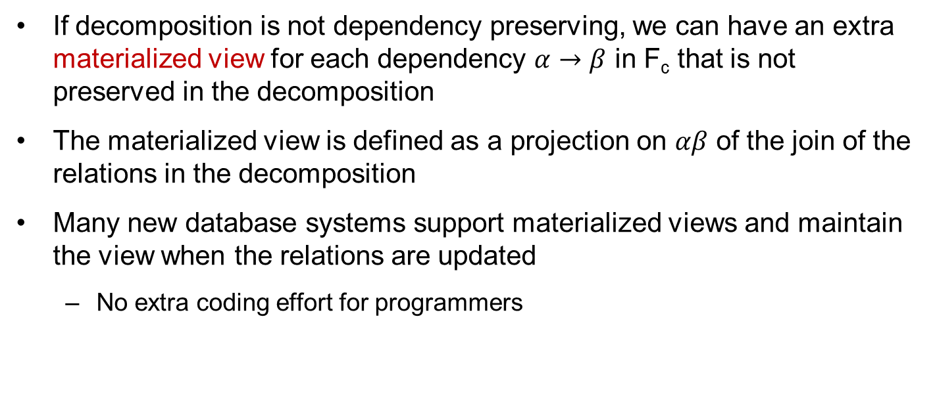
Testing for FDs Across Relations
If decomposition is not dependency preserving, we can have an extra materialized view for each dependency $α→β$ in F_{c} that is not preserved in the decomposition
The materialized view is defined as a projection on $αβ$ of the join of the relations in the decomposition
Many new database systems support materialized views and maintain the view when the relations are updated
  No extra coding effort for programmers

Slide 96
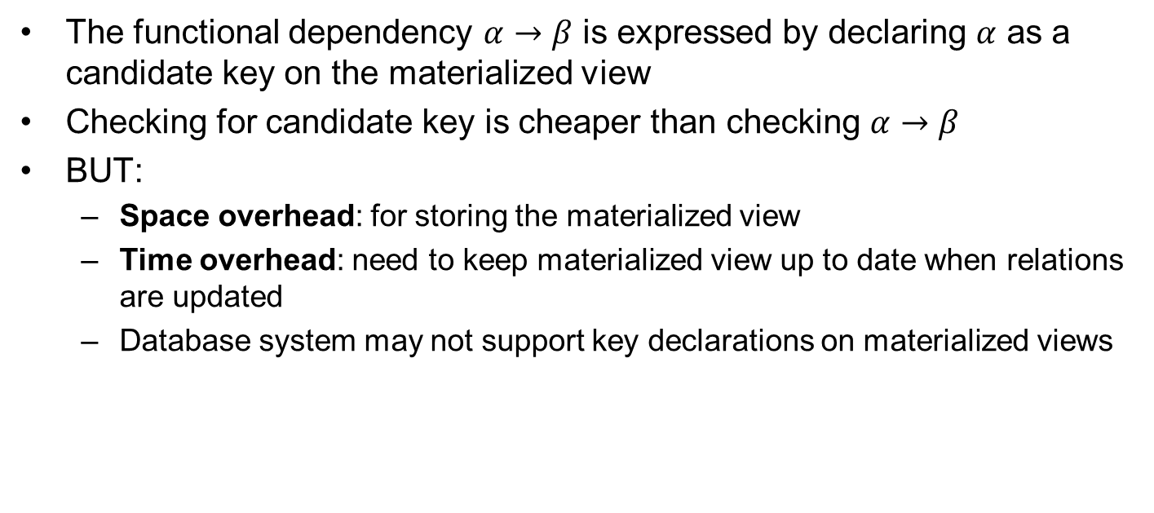
Testing for FDs Across Relations (Cont.)
The functional dependency $α→β$ is expressed by declaring $α$ as a candidate key on the materialized view
Checking for candidate key is cheaper than checking $α→β$
BUT:
  Space overhead: for storing the materialized view
  Time overhead: need to keep materialized view up to date when relations are updated
  Database system may not support key declarations on materialized views

Slide 97
Outline
Features of Good Relational Designs
Functional Dependencies
  Decomposition using Functional Dependencies
  Closure of Functional Dependencies
  Closure of Attribute Sets
  Canonical Cover
  Lossless-join Decomposition
  Dependency Preservation
Normalization & Normal Forms (范式)
Multivalued Dependencies*
Database Design Process

Slide 98
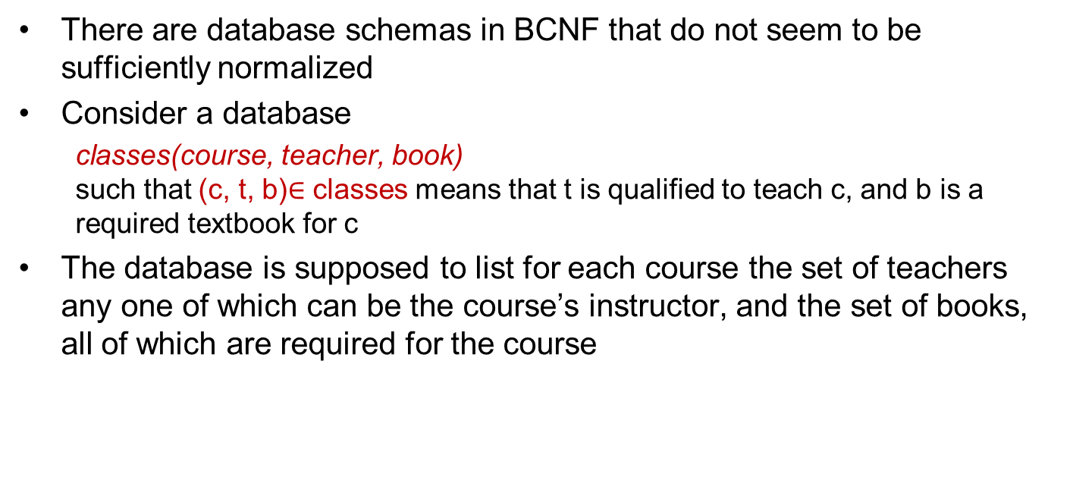
Multivalued Dependencies
There are database schemas in BCNF that do not seem to be sufficiently normalized
Consider a database
  classes(course, teacher, book)
  such that (c, t, b)$∈$ classes means that t is qualified to teach c, and b is a required textbook for c
The database is supposed to list for each course the set of teachers any one of which can be the course’s instructor, and the set of books, all of which are required for the course

Slide 99
course
teacher
book
database
database
database
database
database
database
operating systems
operating systems
operating systems
operating systems
Avi
Avi
Hank
Hank
Sudarshan
Sudarshan
Avi
Avi
Jim
Jim
DB Concepts
Ullman
DB Concepts
Ullman
DB Concepts
Ullman
OS Concepts
Shaw
OS Concepts
Shaw
classes
There are no non-trivial functional dependencies and therefore the relation is in BCNF
Insertion anomalies – i.e., if Sara is a new teacher that can teach database, two tuples need to be inserted
  (database, Sara, DB Concepts)
  (database, Sara, Ullman)

Slide 100
Multivalued Dependencies (Cont.)
Therefore, it is better to decompose classes into:
course
teacher
database
database
database
operating systems
operating systems
Avi
Hank
Sudarshan
Avi
Jim
teaches
course
book
database
database
operating systems
operating systems
DB Concepts
Ullman
OS Concepts
Shaw
text
We shall see that these two relations are in 4NF

Slide 101
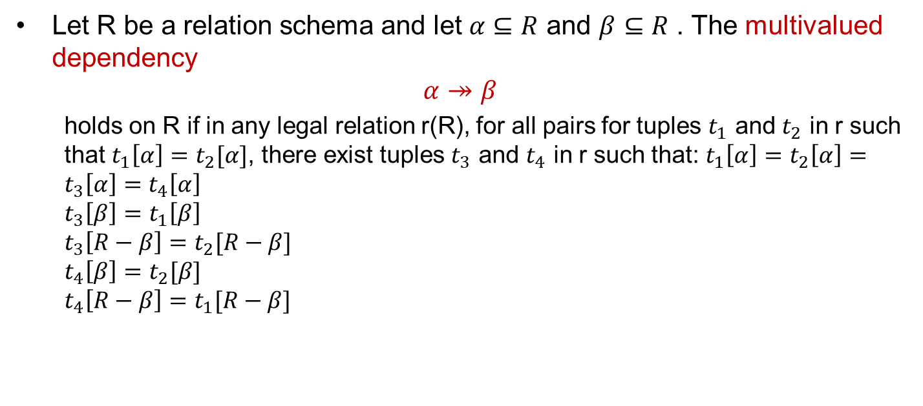
Multivalued Dependencies (MVDs)
Let R be a relation schema and let $α⊆R$ and $β⊆R$ . The multivalued dependency
$$α↠β$$
  holds on R if in any legal relation r(R), for all pairs for tuples $t_{1}$ and $t_{2}$ in r such that $t_{1}\left[α\right]=t_{2}[α]$, there exist tuples $t_{3}$ and $t_{4}$ in r such that: $t_{1}\left[α\right]=t_{2}\left[α\right]=t_{3}\left[α\right]=t_{4}\left[α\right]$
  $$t_{3}\left[β\right]=t_{1}\left[β\right]$$
  $$t_{3}\left[R−β\right]=t_{2}[R−β]$$
  $$t_{4}\left[β\right]=t_{2}[β]$$
  $$t_{4}\left[R−β\right]=t_{1}[R−β]$$

Slide 102
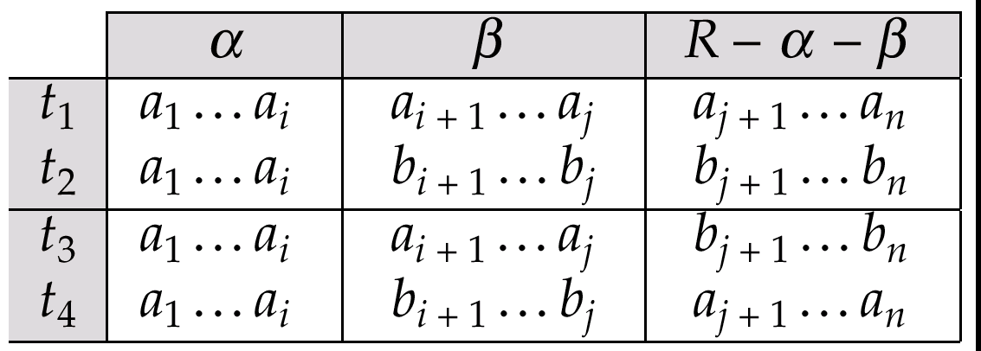

MVD (Cont.)
Tabular representation of $α↠β$
Functional dependencies: equality-generating dependencies 相等产生依赖
Multivalued dependencies: tuple-generating dependencies 元组产生依赖

Slide 103
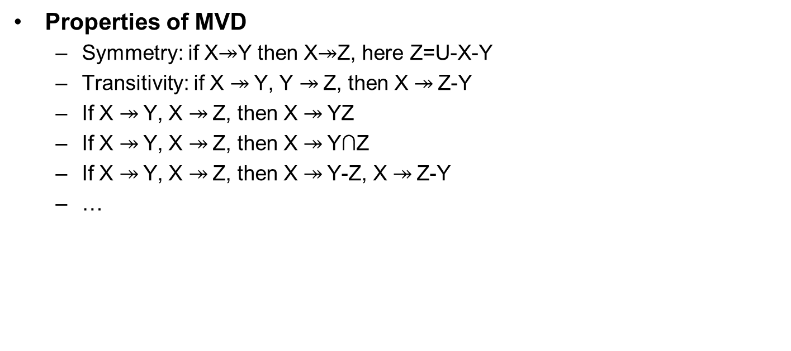
MVD (Cont.)
Properties of MVD
  Symmetry: if X$↠$Y then X$↠$Z, here Z=U-X-Y
  Transitivity: if X $↠$Y, Y $↠$Z, then X $↠$Z-Y
  If X $↠$Y, X $↠$Z, then X $↠$YZ
  If X $↠$Y, X $↠$Z, then X $↠$Y∩Z
  If X $↠$Y, X $↠$Z, then X $↠$Y-Z, X $↠$Z-Y
  …

Slide 104

Example
Let R be a relation schema with a set of attributes that are partitioned into 3 nonempty subsets.
  Y, Z, W
We say that Y$↠$Z (Y multi-determines Z)
iff for all possible relations r(R)
  $<y,z_{1},w_{1}>∈r$ and $<y,z_{2},w_{2}>∈r$ then
  $<y,z_{1},w_{2}>∈r$ and $<y,z_{2},w_{1}>∈r$
Note that since the behavior of Z and W are identical it follows that Y$↠$Z if Y$↠$W

Slide 105

Example (Cont.)
In our example:
  course $↠$ teacher
  course $↠$ book
The above formal definition is supposed to formalize the notion that given a particular value of Y (course) it has associated with it a set of values of Z (teacher) and a set of values of W (book), and these two sets are in some sense independent of each other
Note:
  If Y$→$ Z then Y $↠$ Z
  Indeed we have (in above notation) $z_{1}=z_{2}$
  The claim follows
Notes:
Indeed we have (in above notation) z1 = z2，意思就是假设是多个元组，但相同

Slide 106

Use of Multivalued Dependencies
We use MVDs in two ways:
  To test relations to determine whether they are legal under a given set of FDs and MVDs
  To specify constraints on the set of legal relations. We shall concern ourselves with relations that satisfy a given set of FDs and MVDs.
If a relation $r$ fails to satisfy a given MVD, we can construct a relations $r^{′}$ that does satisfy the MVD by adding tuples to $r$
Notes:
adding tuples to r：意思是不满足一定是缺少一些交换的元组，填上就满足多值依赖了

Slide 107

Theory of MVDs
From the definition of multivalued dependency, we can derive the following rule:
  If $α→β$, then $α↠β$; That is, every FD is also a MVD
The closure D⁺ of D is the set of all FDs and MVDs logically implied by D.
We can compute D⁺ from D, using the formal definitions of FDs and MVDs.
We can manage with such reasoning for very simple MVDs, which seem to be common in practice
For complex MVDs, it is better to reason about sets of dependencies using a system of inference rules

Slide 108

Fourth Normal Form
A relation schema R is in 4NF w.r.t. a set D of FDs and MVDs if for all MVDs in D⁺ of the form $α↠β$, where $α⊆R$ and $β⊆R$, at least one of the following hold:
  $α↠β$ is trivial (i.e., $β⊆α$ or $α∪β=R$)
  $α$ is a superkey for schema R
If a relation is in 4NF it is in BCNF
Notes:
4NF就是要求没有非平凡的多值依赖

Slide 109

Restriction of Multivalued Dependencies
The restriction of D to $R_{i}$ is the set $D_{i}$ consisting of
  All FDs in D⁺ that include only attributes of Ri
  All MVDs of the form
$α↠β$($β∩R_{i}$)
  where $α⊆R_{i}$ and $α↠β$ is in D⁺
Notes:
要检查每个分解是否是4NF，必须要求分解后，D+在各个子表中的投影也满足4NF的判定条件

Slide 110

4NF Decomposition Algorithm
result: = {R};
done := false;
compute D+;
Let $D_{i}$ denote the restriction of D⁺ to $R_{i}$
while (not done)
if (there is a schema $R_{i}$ in result that is not in 4NF) then
begin
let $α↠β$ be a nontrivial MVD that holds on $R_{i}$such that $α→R_{i}$
is not in $D_{i}$, and $α∩β=∅$;
result := (result - $R_{i}$) $∪$ (($R_{i}$ -$β$) $∩$ ($α$, $β$));
end
else done:= true;
Note: each $R_{i}$is in 4NF, and decomposition is lossless-join
Notes:
无损连接，但不一定保持依赖

Slide 111
Example
R =(A, B, C, G, H, I)
F ={ A →→ B
B →→ HI
CG →→ H }
R is not in 4NF since A →→ B and A is not a superkey for R
Decomposition
a) R₁ = (A, B) (R₁ is in 4NF)
b) R₂ = (A, C, G, H, I) (R₂ is not in 4NF)
c) R₃ = (C, G, H) (R₃ is in 4NF)
d) R₄ = (A, C, G, I) (R₄ is not in 4NF)
Since A →→ B and B →→ HI, A →→ HI, A →→ I
e) R₅ = (A, I) (R₅ is in 4NF)
f)R₆ = (A, C, G) (R₆ is in 4NF)

Slide 112
Further Normal Forms
Join dependencies generalize MVDs
  lead to project-join normal form (PJNF) (also called fifth normal form) 投影-连接范式
A class of even more general constraints, leads to a normal form called domain-key normal form (DKNF) 域-码范式
Problem with these generalized constraints: are hard to reason with, and no set of sound and complete set of inference rules exists
Hence rarely used

Slide 113
Outline
Features of Good Relational Designs
Functional Dependencies
  Decomposition using Functional Dependencies
  Closure of Functional Dependencies
  Closure of Attribute Sets
  Canonical Cover
  Lossless-join Decomposition
  Dependency Preservation
Normalization & Normal Forms (范式)
Multivalued Dependencies*
Database Design Process

Slide 114

E-R Model and Normalization
When an E-R diagram is carefully designed, identifying all entities correctly, the tables generated from the E-R diagram should not need further normalization
However, in a real (imperfect) design, there can be FDs from non-key attributes of an entity to other attributes of the entity
  E.g., employee entity with attributes dept_name and dept_address, and an FD
  dept_name $→$ dept_address
  Good design would have made department an entity
FDs from non-key attributes of a relationship set are possible, but rare

Slide 115

Denormalization for Performance
Use non-normalized schema for performance
  E.g., displaying customer-name along with account-number and balance requires join of account with depositor
  Alternative 1: use a denormalized relation that contains attributes of both account and depositor
    faster lookup
    extra space and extra execution time for updates
    extra coding work for programmers and possibility of error in extra code
  Alternative 2: use a materialized view defined as account $⋈$ depositor
    benefits and drawbacks same as above, except no extra coding work for programmers and avoids possible errors

Slide 116
Other Design Issues
Some aspects of database design are not caught by normalization
Examples of bad database design to be avoided: Instead of earnings(company-id, year, amount), use
  earnings-2000, earnings-2001, earnings-2002, etc., all on the schema (company-id, earnings)
    Above are in BCNF, but make querying across years difficult and needs a new table each year
  company-year(company-id, earnings-2000, earnings-2001, earnings-2002)
    Also in BCNF, but make querying across years difficult and requires new attribute each year.
    Is an example of a crosstab, where values for one attribute become column names
    Used in spreadsheets, and in data analysis tools
Notes:
Crosstab:交叉表
Spreadsheets:电子数据表

Slide 117

Quiz
Given the relational schema R<U, F>, U={A,B,C,D,E}, F={AC$→$BD, B $→$C, C $→$D, B $→$E}
  use Armstrong axioms and related rules to prove the functional dependency AC $→$E
  compute (A)⁺ and (AC)⁺
  find a canonical cover F_{c} of F
  find all candidate keys, and point out R is in which normal form
  decompose R into 3NF such that the decomposition is lossless-join and dependency preserving.
  give related explanation or proof that the above decomposition is lossless-join and dependency preserving
  *decompose the relation into relations in BCNF

Slide 118
Homework
Exercises
  7.1, 7.6，7.30(a, b, c, d)
Submission
  Canvas上提交，上传单个PDF文件

Slide 119
End of Chapter 7

